Slide 1
Twelfth Annual REIA/DePaul Summit
Interest Rates, Demographic Shifts, Densification/Urbanization, and Political Risk and What to Do About It
September 22, 2016
James D. Shilling
DePaul University
Professor and Michael J. Horne Chair
in Real Estate Studies

Slide 2
Twelfth Annual REIA/DePaul Summit
Market at a Glance
Record rise in US real estate prices
Moody’s/RCA Commercial Property Price Indices
Source: Moody’s/Real Capital Analytics

Slide 3
Twelfth Annual REIA/DePaul Summit
Market at a Glance
US real estate market activity is still high but losing steam
USD mil
Based on Sales of Properties $2.5 Million or Greater
Source: Real Capital Analytics

Slide 4
Twelfth Annual REIA/DePaul Summit
Market at a Glance
Cap rates in the US are now at or near a record low
Cap Rates from Properties that are Included in the NPI Index, %
Source: NCREIF Database

Slide 5
Twelfth Annual REIA/DePaul Summit
Market at a Glance
Vacancy rates continue to improve in all of the major sectors
Vacancy Rates for Properties Owned by NCREIF Members, %
Source: NCREIF Database

Slide 6
Twelfth Annual REIA/DePaul Summit
Market at a Glance
Same property NOI continues to grow at a high rate
NOI Growth Rate 4 Quarter Moving Average for Properties that are in the NPI Index, %
Source: NCREIF Database

Slide 7
Twelfth Annual REIA/DePaul Summit
Three Debates About the Real Estate Market
Debate #1. Do the record low cap rates in core commercial
properties signal that the market is overheated?
Current Value Cap Rates and Spreads over Yield on 10-year Treasury Securities, %
Source: NCREIF Database, Federal Reserve Board (FRB)

Slide 8
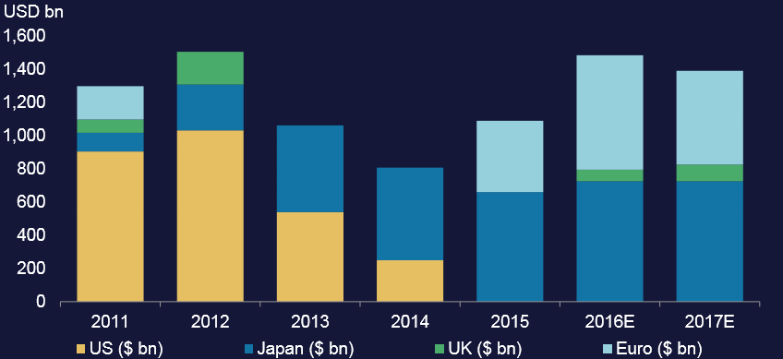
Twelfth Annual REIA/DePaul Summit
Three Debates About the Real Estate Market
Central Banks Are Buying a Lot of Bonds
Central Banks’ Purchases of Government Bonds
Source: Morgan Stanley Research

Slide 9
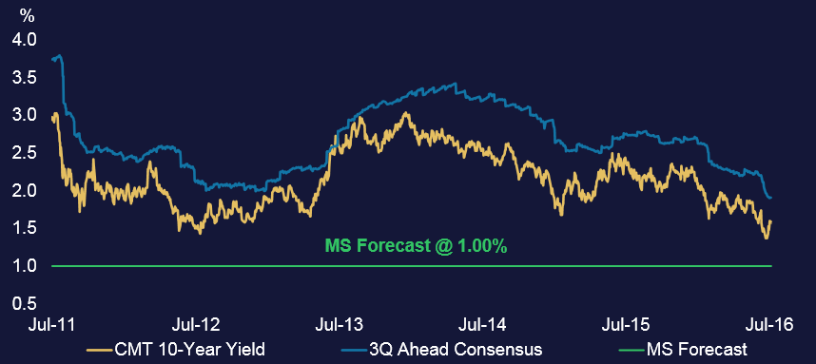
Twelfth Annual REIA/DePaul Summit
Three Debates About the Real Estate Market
Global Yield Curves are Flattening. Real Estate is Sensitive
to Slope of Yield Curve. More Flattening Could Lower Cap
Rates Even Further.
Constant Maturity 10-year Treasury Yield, %
Source: Morgan Stanley Research

Slide 10
Twelfth Annual REIA/DePaul Summit
Three Debates About the Real Estate Market
Debate #2. Has Chicago reached the peak rental housing
market? Will multi-family development continue to be
strong? Will the move to higher density areas continue?
Multifamily Housing Starts in Cook County, 2000-2016 (in units)
Source: US Bureau of the Census

Slide 11
Twelfth Annual REIA/DePaul Summit
Favorable demographics have been the key
Positive net absorption has returned as Millennials move
into the 25 to 30 year old age group (a key age group for
renters).
Net Absorption of Space in Cook County (in units)
Source: Author’s estimates. Net absorption accounts for space vacated during the period as well as new additions (ex. new construction) over the applicable period and units lost to condo conversions in the 2000s.

Slide 12
Twelfth Annual REIA/DePaul Summit
Longer term trend for two key age groups
Longer term trend suggests demand for apartments will
soften starting around 2020 +/-
ACS Population Estimates and IDPH Projections for Cook County,
1980-2025
Source: American Community Survey (ACS) and Illinois Department of Public Health (IDPH)

Slide 13
Twelfth Annual REIA/DePaul Summit
Expect real GDP come 2020 of $54K per
capita rather than $61K per capita.
Trend points to greater affordability problems and more
individuals remaining renters instead of owners.
USD
Chained 2009 Dollars, Real Gross Domestic Product Per Capita
Source: US Bureau of Economic Analysis

Slide 14
Twelfth Annual REIA/DePaul Summit
Three Debates About the Real Estate Market
Debate #3. Political risk. Macroeconomic impact of
Trump’s policies would result in a less global US economy.
USD, tril
Real Gross Domestic Product, in
Constant 2009$ (trillion)
Source: US Bureau of Economic Analysis, Moody’s Analytics

Slide 15
Twelfth Annual REIA/DePaul Summit
Three Debates About the Real Estate Market
Commercial real estate values could fall up to 10% in the
short-run with adoption of Trump’s economic policies.
Moody’s/Real Capital Analytics Commercial Property Price Index, Office
Source: Moody’s Analytics, Author’s Calculations

Slide 16
Twelfth Annual REIA/DePaul Summit
Key Takeaways
For cap rates: A flattening yield curve is good for real
estate values. Lower yields could drive commercial real
estate values even higher.
For Chicago: Demographics are favorable for apartments
until 2020 +/-. Look for densification/urbanization to
continue in near term. Sluggish wage growth to create
affordability problems and steepen bid-rent curves.
Conditions favor renting over owning. Micro apartments
are helping to provide affordable alternatives for
Millennials. Competition for land in some areas is a supply
constraint.
Risks: Presidential election poses downside risks for
commercial real estate markets.

