Slide 1
TransIT Oriented Development
Sullivan Goulette & Wilson, Ltd.

Slide 2
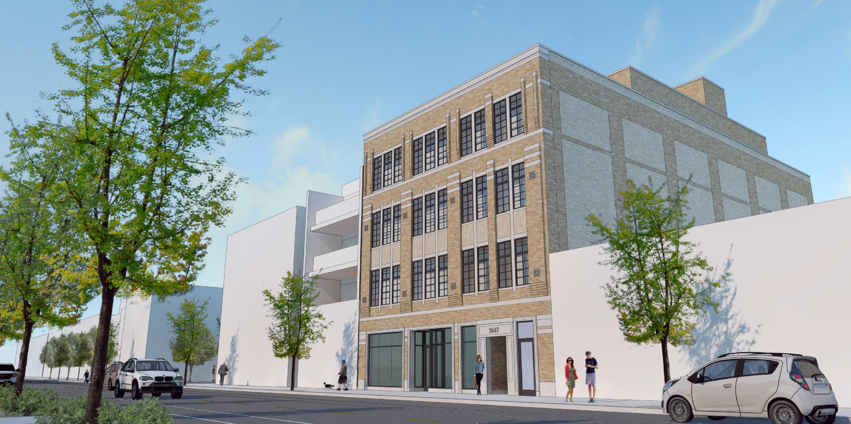
3647 N. Southport Avenue

Slide 3
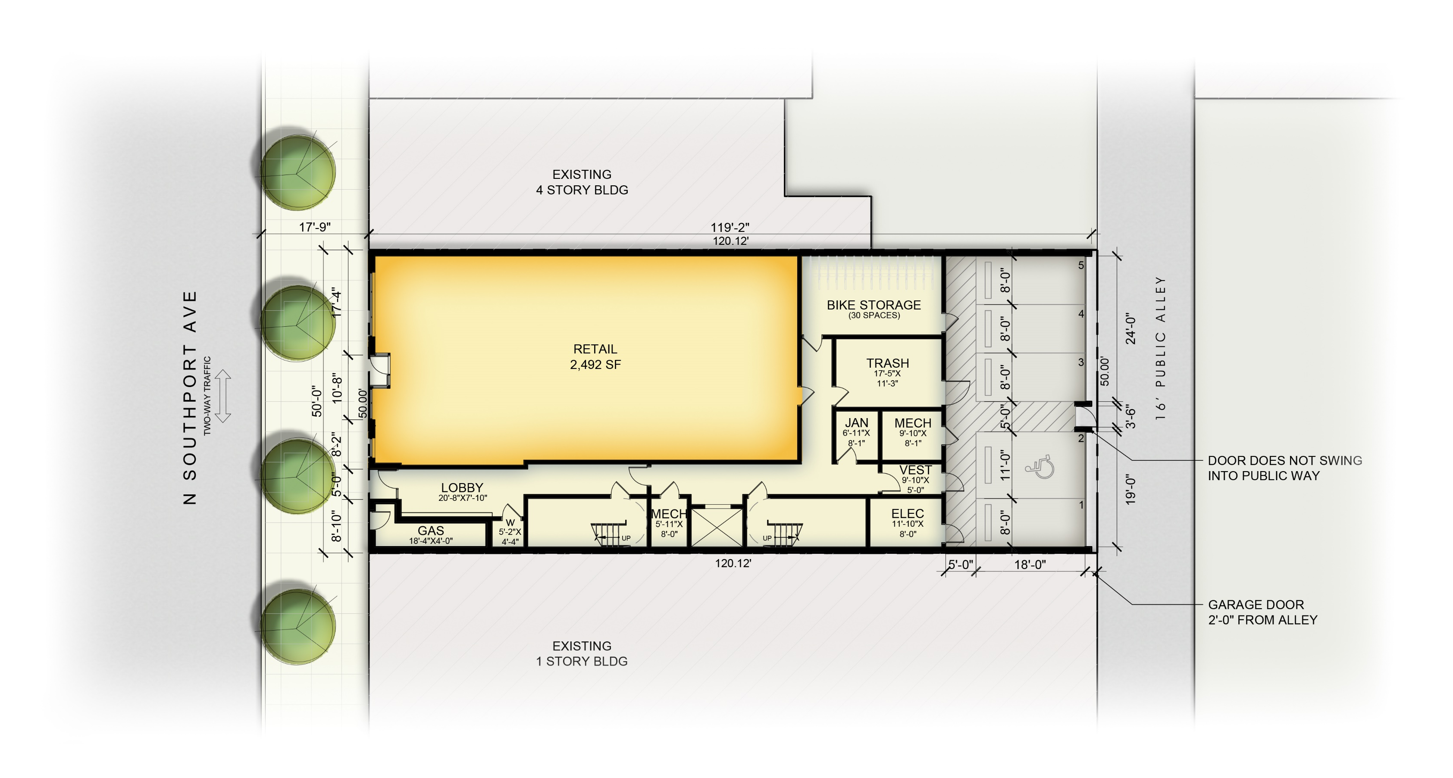

Slide 4
4620 N. Western Avenue

Slide 6
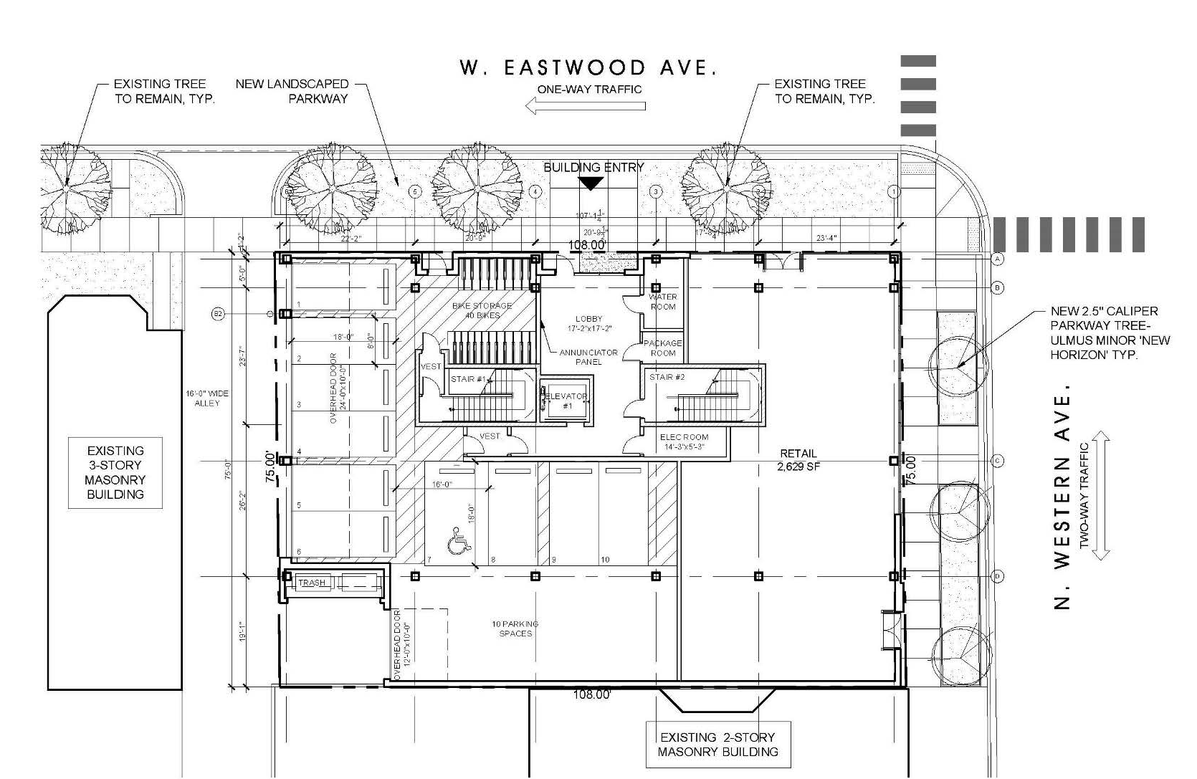

Slide 7
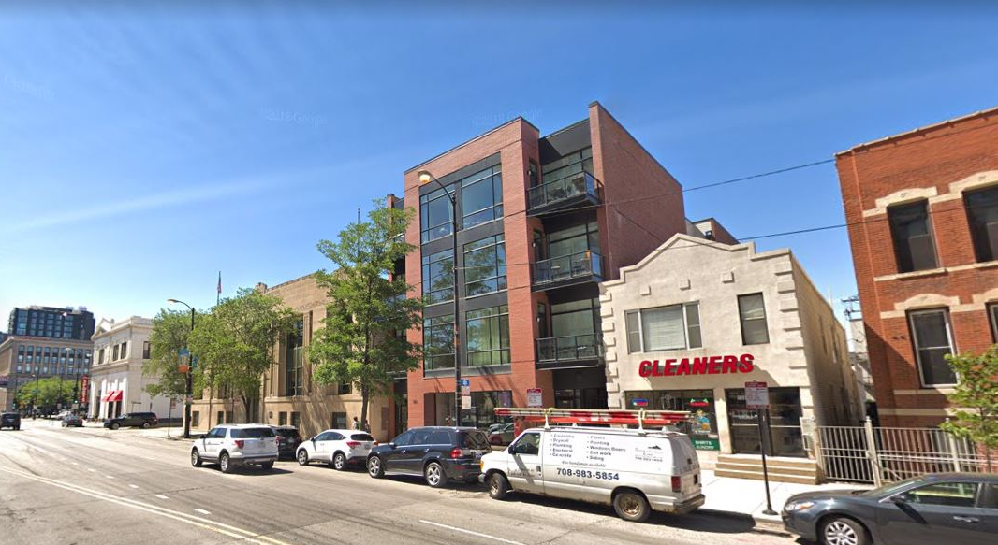
1510 W. Division Street

Slide 8
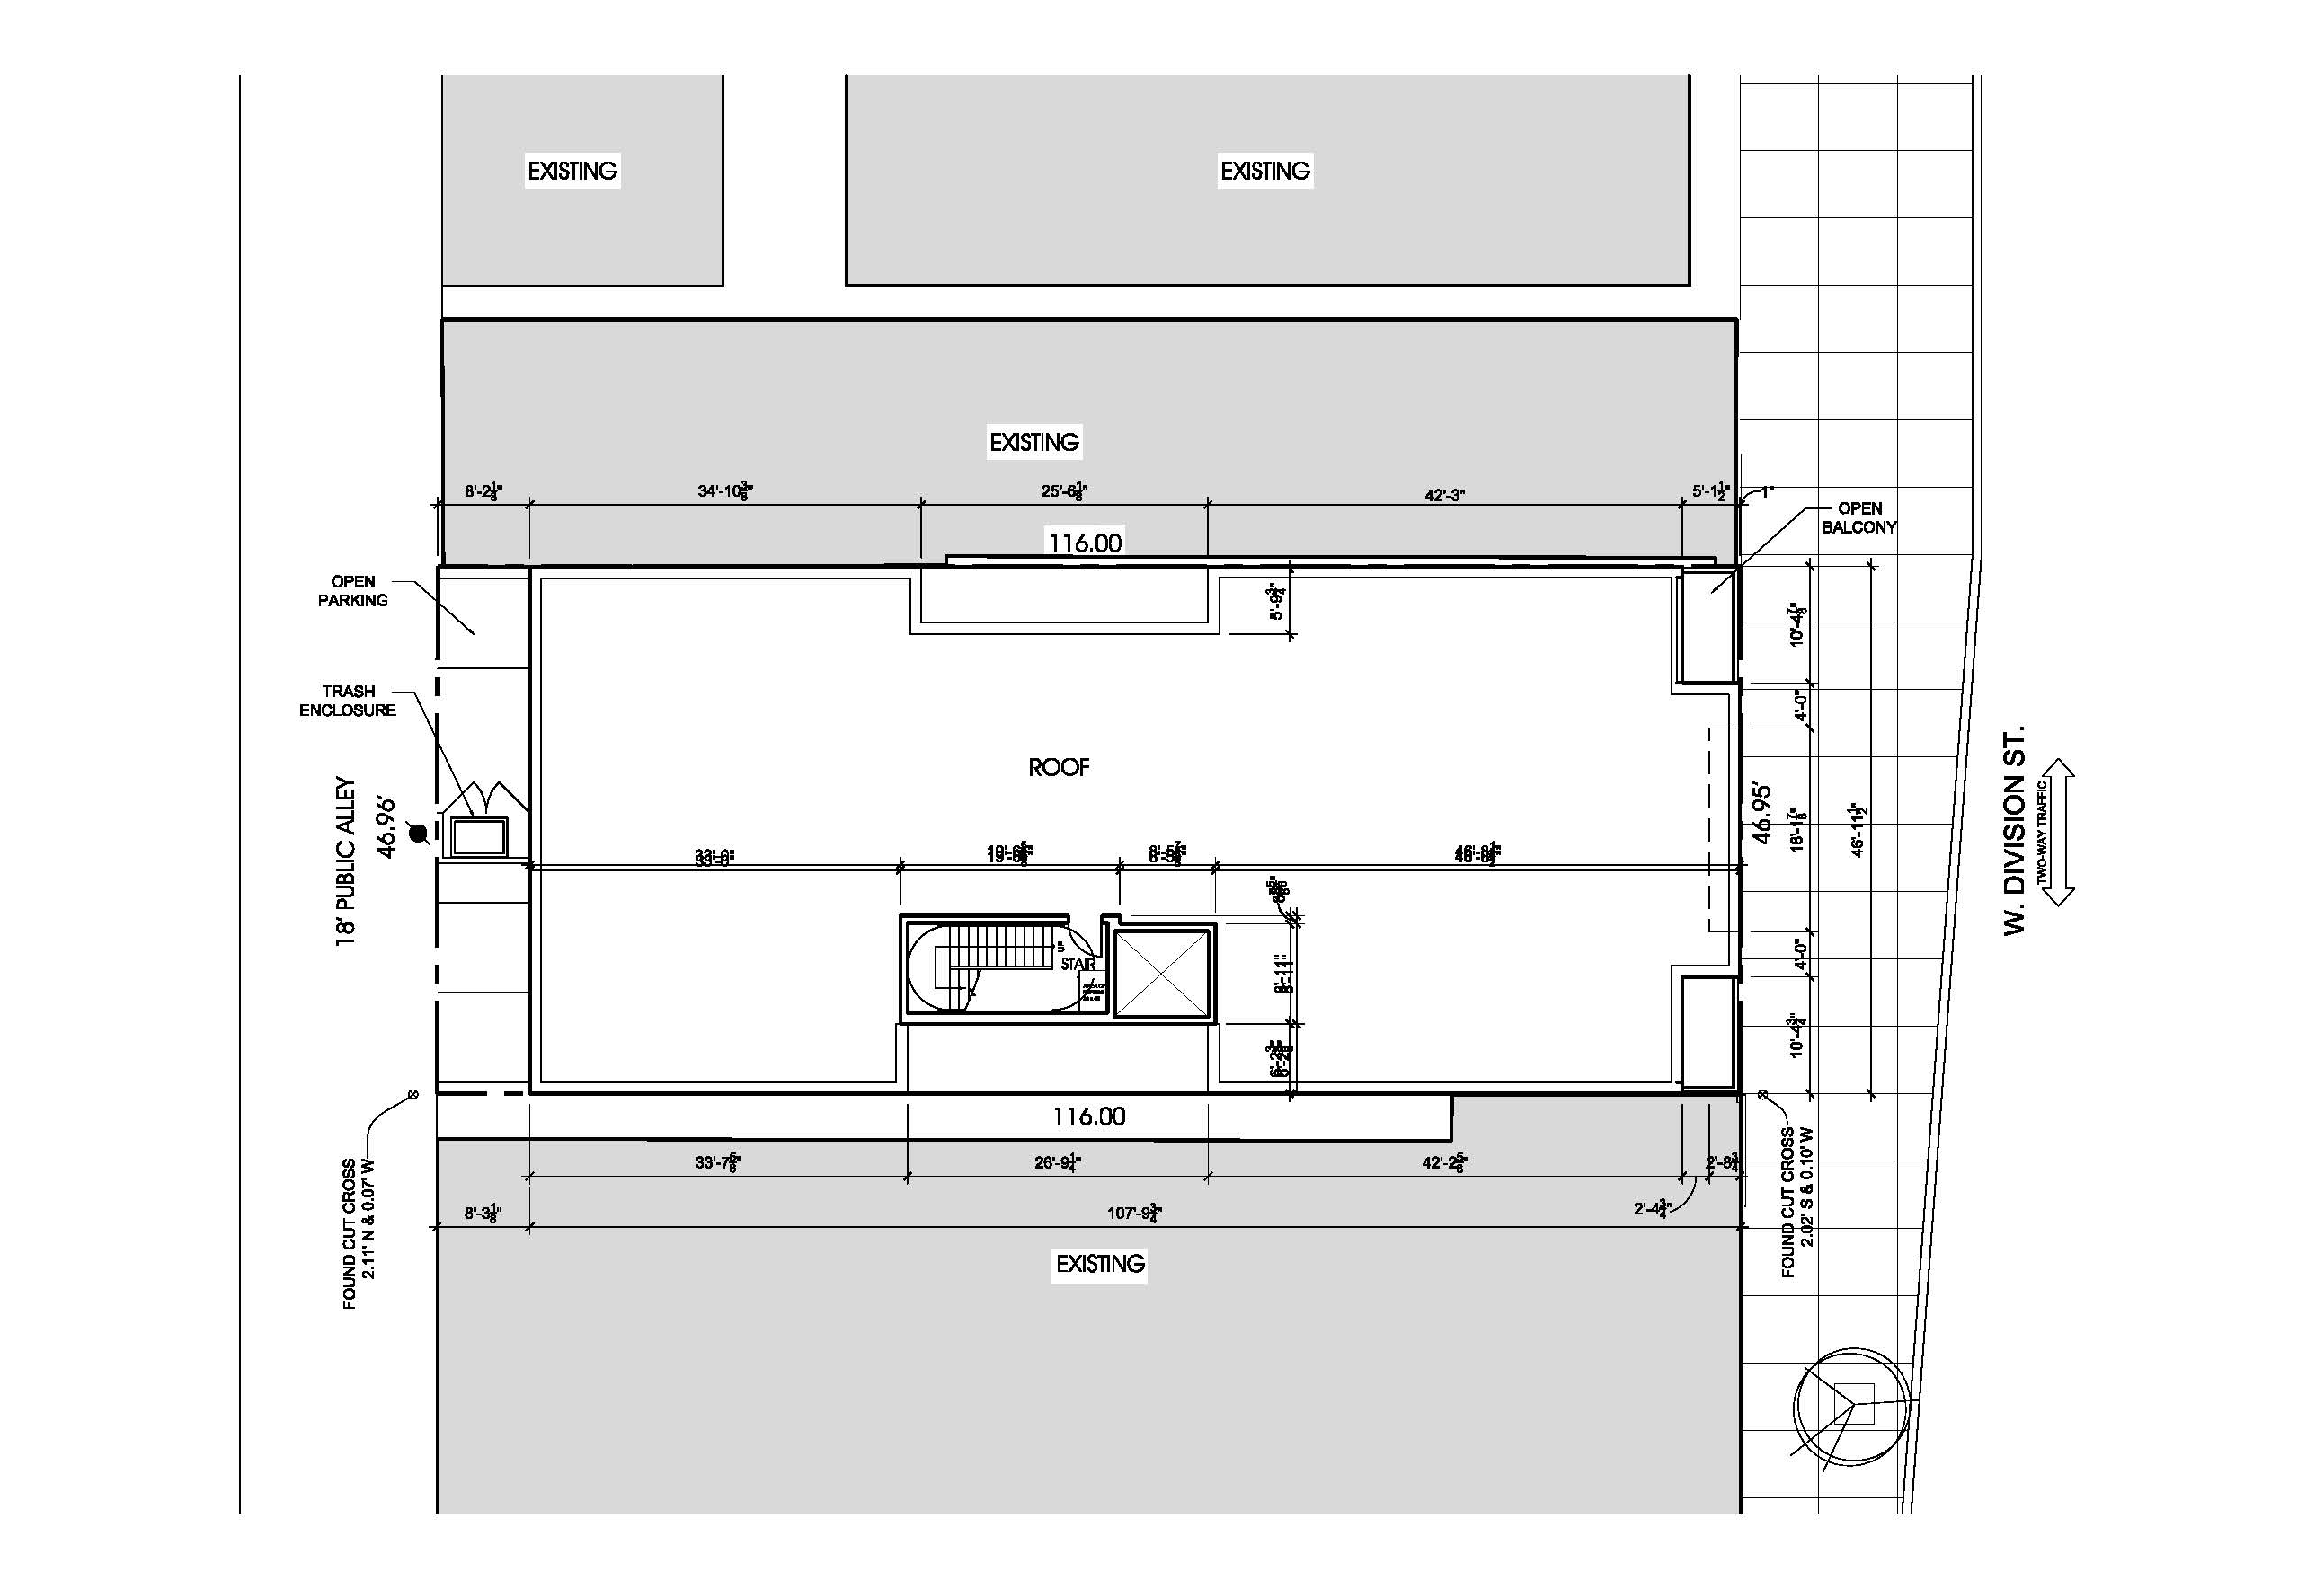

Slide 9
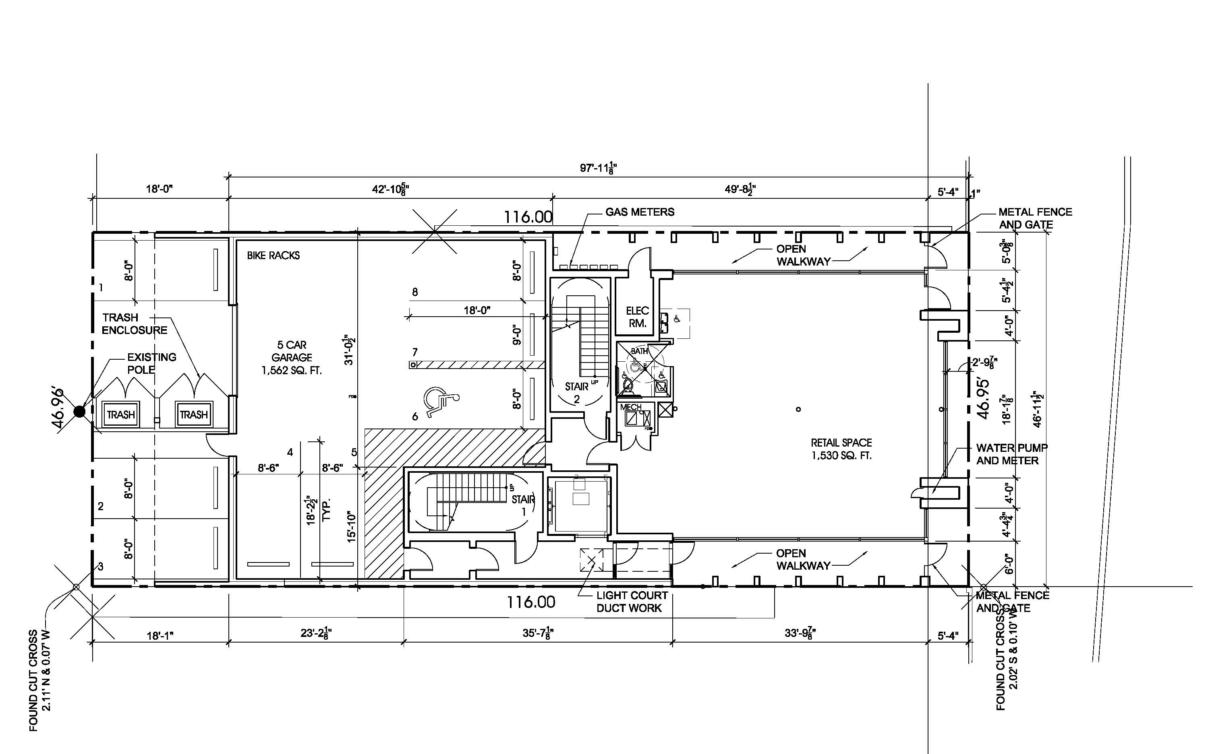

Slide 10
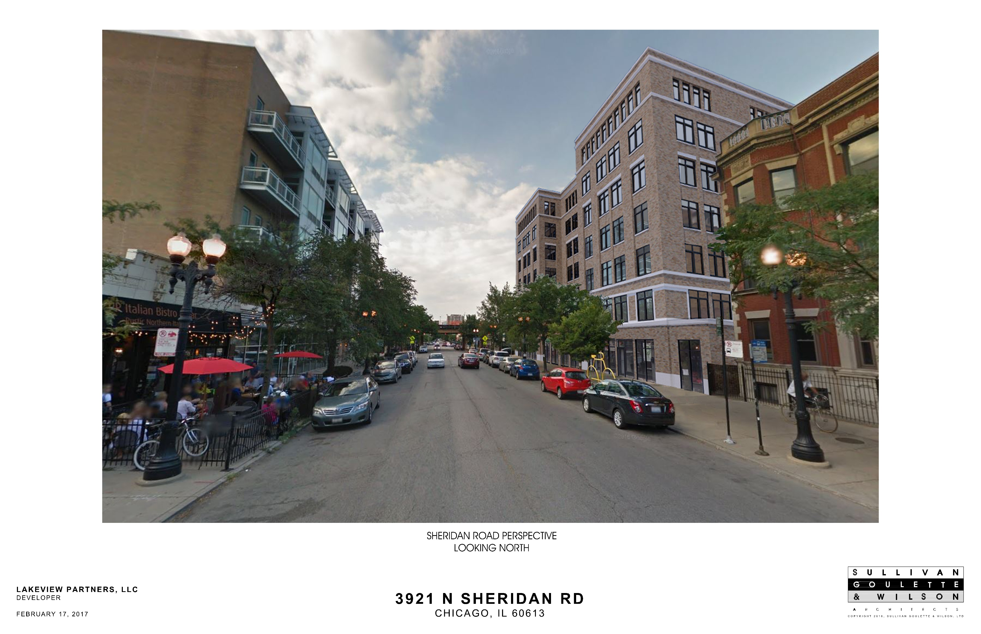
3921 N. Sheridan Road

Slide 11
3921 N. Sheridan Road

Slide 12
