Slide 1
Thirteenth Annual REIA/DePaul Summit
Cyclical vs structural changes in the real estate market
Implications for where the real estate market is heading in 2017 and beyond and the challenges/opportunities ahead
September 21, 2017
James D. Shilling
DePaul University
Professor and George R. Ruff Chair
in Real Estate Studies

Slide 2
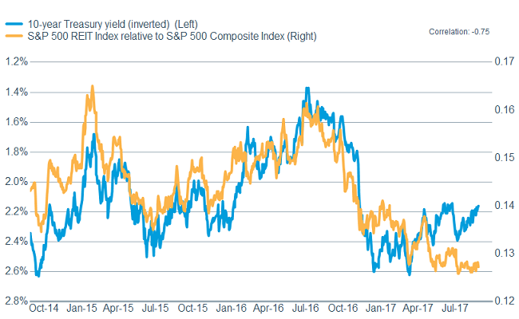
Thirteenth Annual REIA/DePaul Summit
In the Near Term
Higher interest rates could mean trouble for real estate values
10-year Treasury Yield (Inverted), %
S&P 500 REIT Index relative to S&P 500 Composite Index
Source: Bloomberg, Standard & Poors

Slide 3
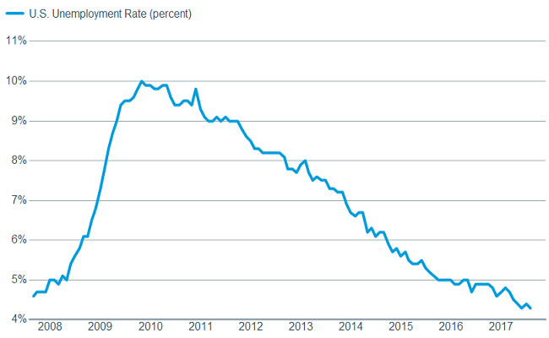
Thirteenth Annual REIA/DePaul Summit
In the Near Term
Low unemployment could contribute to higher interest rates
Number of Unemployed as a Percentage of the Labor Force
Source: US Bureau of Labor Statistics

Slide 4
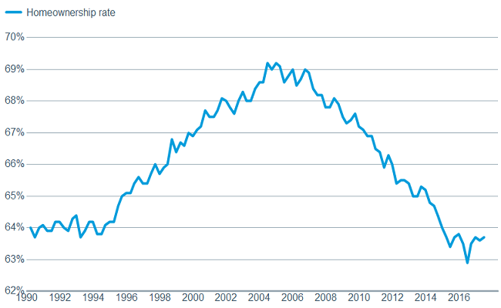
Thirteenth Annual REIA/DePaul Summit
In the Near Term
The homeownership rate could move higher
Proportion of Households that is Owner-Occupied, %
Source: US Census Bureau

Slide 5
Thirteenth Annual REIA/DePaul Summit
In the Near Term
Lending standards have been getting tighter
Percentage of Banks Tightening Standards for Commercial Real Estate Loans, %
Source: Board of Governors, Federal Reserve System

Slide 6
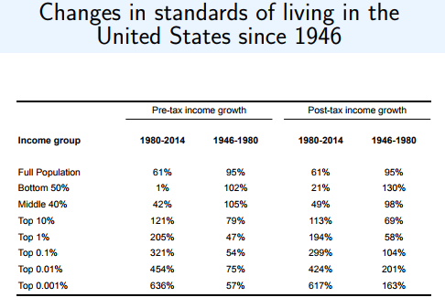
Thirteenth Annual REIA/DePaul Summit
Forces Shaping the Outlook in 2017 and Beyond
The income inequality challenge: rising income gaps in the
US as well as in advanced countries
Source: Piketty, Saez, and Zucman (2016)

Slide 7
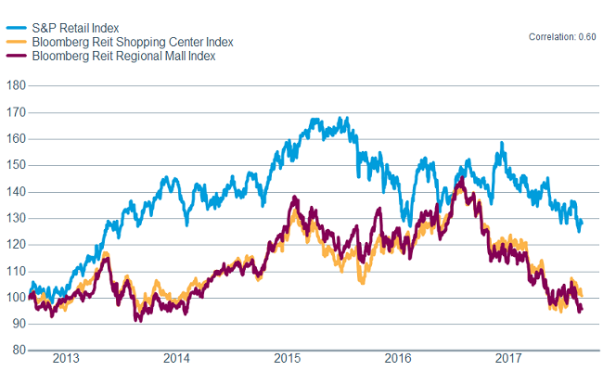
Thirteenth Annual REIA/DePaul Summit
Forces Shaping the Outlook in 2017 and Beyond
More upheaval in retail sector is likely
S&P Retail Index and Bloomberg REIT Retail Indices
Source: Bloomberg, Standard & Poors

Slide 8
Thirteenth Annual REIA/DePaul Summit
Four Key Takeaways
Global economic growth in 2017 and beyond will slow (mainly due
to ageing) and will be increasingly driven by innovation and
investment skills.
Major shifts in the retail sector will likely continue as the sector
“staggers” towards long-term recovery (including a trend toward
experiential retail, a shift to “Omni Channel,” a trend toward new
fulfillment models and new distribution methods, and the
repositioning of a number of centers as retailers shutter physical
stores and/or go out of business altogether).
Rising income gaps in advanced countries will create a strong
demand for “workforce” housing.
Investors need to be prepared for a shifting debt market. Bank
lending standards have been getting tighter. Most insurance
companies have a mechanism that slows down lending as allocations
are reached. Such constraints are likely to cause a rise in
non-bank lenders.

