Slide 1
REIA Webinar 2021 A Look Ahead: The Start of a New Cycle February 4, 2021 James D. Shilling DePaul University
Professor and George R. Ruff Chair
in Real Estate Studies

Slide 2
REIA Webinar
Where We Were Headed Pre-COVID
State of the Chicago Real Estate Market
1. Expansion of the US Economy from 2009-2020 was Among the Longest on Record
2. Rental Growth had been Strong but Slowing
3. Vacancy Rates had Moved to New Lows for the Cycle
4. Concerns were Rising
Optimism was Stumbling
Issues Concerning the Ability to Raise Debt and Equity Financing
Trepidations Around Pronounced Increases in Asset Prices
Growing Uncertainty of the Cook County Property Taxes
Feb. 4, 2021 (Thursday) 2021 A Look Ahead: A New Economic Cycle

Slide 3
REIA Webinar
Where We Were Headed Pre-COVID
Expansion of the US Economy from 2009-2020 was Among the Longest on Record
Economic Growth Rate
Feeling sluggish?
Does it feel like investment will never, ever go up?
Average growth from 2009-2020 was much slower than in previous expansion
Economy appears to be moderating toward a long-term trend of 2-2.5% real GDP growth
Symptoms include persistently low interest rates and weak inflation
Source: U.S. Bureau of Economic Analysis
Feb. 4, 2021 (Thursday) 2021 A Look Ahead: A New Economic Cycle

Slide 4
REIA Webinar
Where We Were Headed Pre-COVID
Rental Growth had Slowed and Vacancy Rates had Moved to New Lows
Chicago Rental Growth Rates
Chicago Vacancy Rates
Rent/Vacancy Cycle
More of a supply shock as opposed to a demand shock
Consistently positive rental growth but weakness was gaining strength
Not the sweetest of spots for real estate investor performance
Apartments were the big winner in real estate – no doubt being driven by demographic changes, gentrification, and income stagnation for all but the highest wage earners
Source: NCREIF
Feb. 4, 2021 (Thursday) 2021 A Look Ahead: A New Economic Cycle

Slide 5
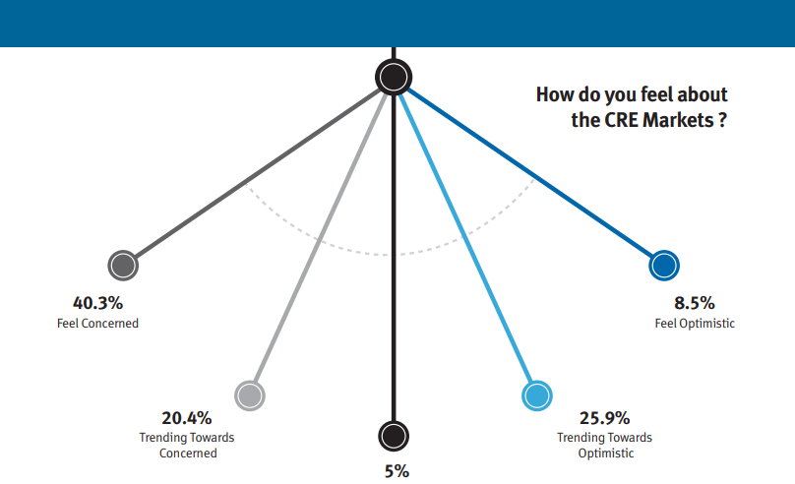
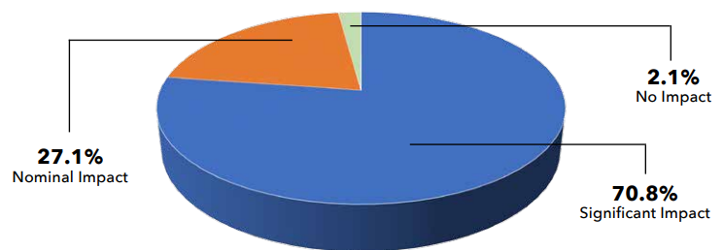
REIA Webinar
Where We Were Headed Pre-COVID
Concerns were Rising
Bears were Back in Force in Chicago’s Real Estate Community
Local Property Taxes are Taxing Real Estate Opportunities
Investor Sentiment
Expectations were falling
However, no “free fall” was in sight
Most were cautiously optimistic
Cook County property taxes have been the biggest threat three-years running
Property tax increases for commercial and industrial property may be shifted to a greater degree than those on rental property
Source: Real Estate Center at DePaul University, 2018-2020 Mid-Year Perspective on Chicago Real Estate Markets
Feb. 4, 2021 (Thursday) 2021 A Look Ahead: A New Economic Cycle

Slide 6
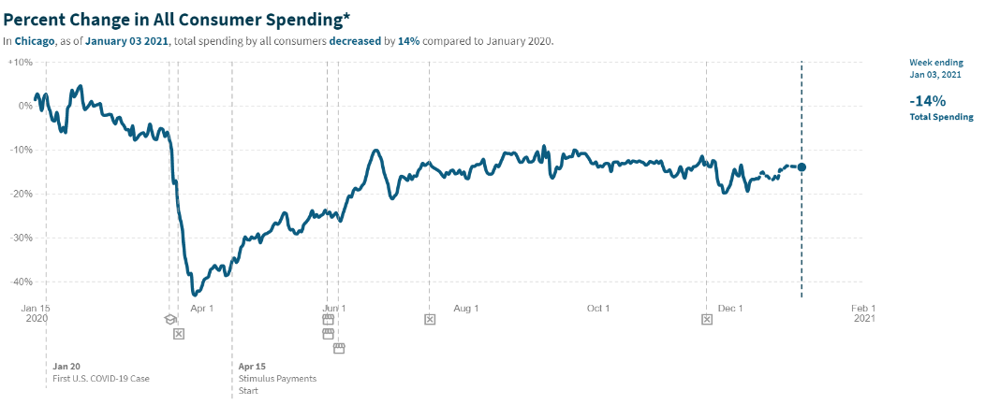
REIA Webinar
The Shape of the COVID Recovery
Most Markets have Experienced a V-Shaped Recovery
Key Insights
In the US, as of Jan. 17, 2021, total spending by all consumers was 6.2% higher than Jan. 2020
Full-year GDP in 2020 is expected to be down only 4%
Ironically, the V-shaped recovery created what turned out to be one of the best years for equity markets and other financial assets.
Reduction in spending coming largely from high-wage earners
Source: tracktherecovery.org
Feb. 4, 2021 (Thursday) 2021 A Look Ahead: A New Economic Cycle

Slide 7
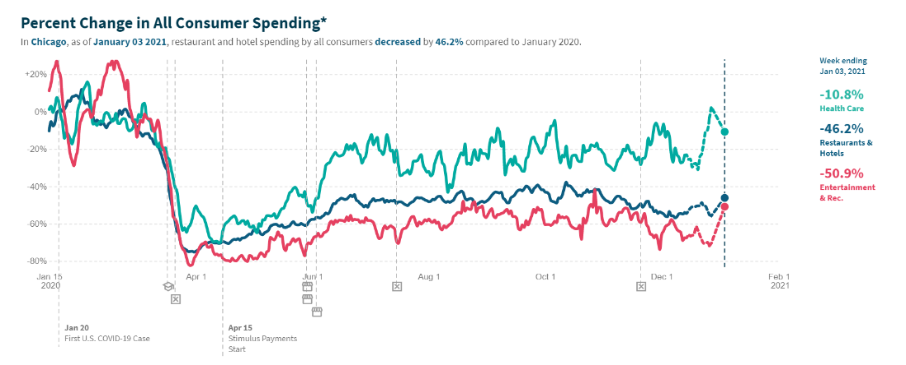
REIA Webinar
The Shape of the COVID Recovery
High-Income Households have Sharply Reduced their Spending on In-Person Services
Key Insights
On what did people cut their spending?
In-person services, like health care (-10.8%), restaurants & hotels (-46.2%), and entertainment & recreation (-50.9%)
These results are quite intuitive.
High-income consumers have reduced their spending on in-person services out of concern about potential exposure to COVID.
Source: tracktherecovery.org
Feb. 4, 2021 (Thursday) 2021 A Look Ahead: A New Economic Cycle

Slide 8
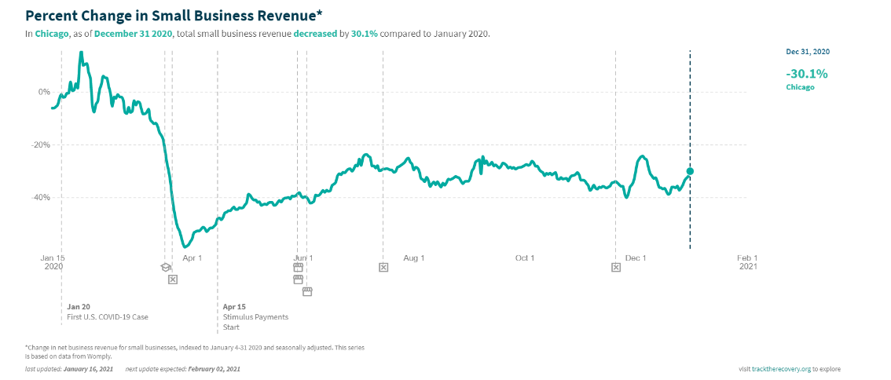
REIA Webinar
The Shape of the COVID Recovery
Highest-Rent ZIP Codes have Lost More than Half of Their Small Business Revenues
Key Insights
Small business revenues in Chicago have decreased by 30.1% compared to Jan. 2020.
These decreases are larger in more affluent areas than less affluent areas.
To balance their books, these small businesses have had little choice but to reduce payroll in response to income lost during the pandemic.
Source: tracktherecovery.org
Feb. 4, 2021 (Thursday) 2021 A Look Ahead: A New Economic Cycle

Slide 9
REIA Webinar
Where is the Chicago Real Estate Market Headed Post-COVID
2021 will Mark the Beginning of a New Real Estate Cycle for Chicago
1. Economic Growth should Accelerate in 2021
2. The Vaccine Rollout will Help and Disproportionately Benefit Highest-Rent Zip Codes
3. Positives for the Market
High-Income Households have Built Up Savings Faster than Normal
Low Interest Rates are a Positive for Funding
Attractive Pricing
4. Negatives for the Market
Pandemic may Exacerbate Some Trends and Reverse Others
Caution for Offices
Shifts to More Affordable Areas (as Living Near One’s Workplace is Far Less Relevant)
Shifts to E-commerce from Brick-and-Mortar Stores
Vacancies Left Behind by Failed Retailers
Feb. 4, 2021 (Thursday) 2021 A Look Ahead: A New Economic Cycle

Slide 10
REIA Webinar
Where is the Chicago Real Estate Market Headed Post-COVID
Commercial Real Estate Pricing in the Chicago Market
Spreads between Capitalization Rates and 10-year Treasury Yield in the Chicago Market
Key Insights
Above-Average Spreads
Apartments
Industrial
Office
Average Spreads
Retail
Talk of opportunity around distressed asset sales, such deals have yet to arrive in great number
Source: NCREIF
Feb. 4, 2021 (Thursday) 2021 A Look Ahead: A New Economic Cycle

Slide 11
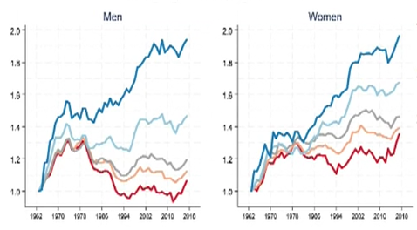
REIA Webinar
Where is the Chicago Real Estate Market Headed Post-COVID
Vacancy Rates for Affordable Multifamily Housing will Remain Relatively Low in 2021
Cumulative Change in Real Weekly Earnings 1963-2017
Working Age Adults, Ages 18-67
Rise of Wage Inequality Starting in the 1980s
Post-college educated
80 to 100% real rise
Four-year college
40 to 60% rise
High school or less
Real wages have fallen among men
Have barely budged among women
COVID has increased wage inequality across income, across socioeconomic groups, and between genders.
Source: Bureau of Labor Statistics
Feb. 4, 2021 (Thursday) 2021 A Look Ahead: A New Economic Cycle

Slide 12
REIA Webinar
2021 Chicago Real Estate Market Outlook
Strong Demand Has Put Pressure on Inventories and Demand for Industrial Space
Key Insights
One trend in spending has been a shift away from services into goods sectors.
As a consequence, in those areas where demand has accelerated, lean inventories have developed.
Understocking is detrimental to online retailing.
COVID vaccine has increased demand for temperature-controlled storage spaces across the globe.
Percentage Change in Real Nonfarm Inventories
Source: Bureau of Economic Analysis
Feb. 4, 2021 (Thursday) 2021 A Look Ahead: A New Economic Cycle

