Slide 1
REIA/DePaul Summit Webinar Chicago’s Real Estate Outlook: Opportunity Insights September 23, 2021 James D. Shilling DePaul University
Professor and George R. Ruff Chair
in Real Estate Studies

Slide 2
REIA/DePaul Summit Webinar
Opportunities Going Forward
State of the Chicago Real Estate Market
1. Rebound in consumer spending is making the opportunity to invest in real
estate timely
2. Pandemic hasn’t changed everything, rather it has accelerated
already-present underlying trends
3. Broad impact on real estate market will evolve over the coming years,
but many sectors are on a dramatically different trajectory
Sept. 23, (Thursday) 2021 Chicago Real Estate: Opportunity Insights

Slide 3
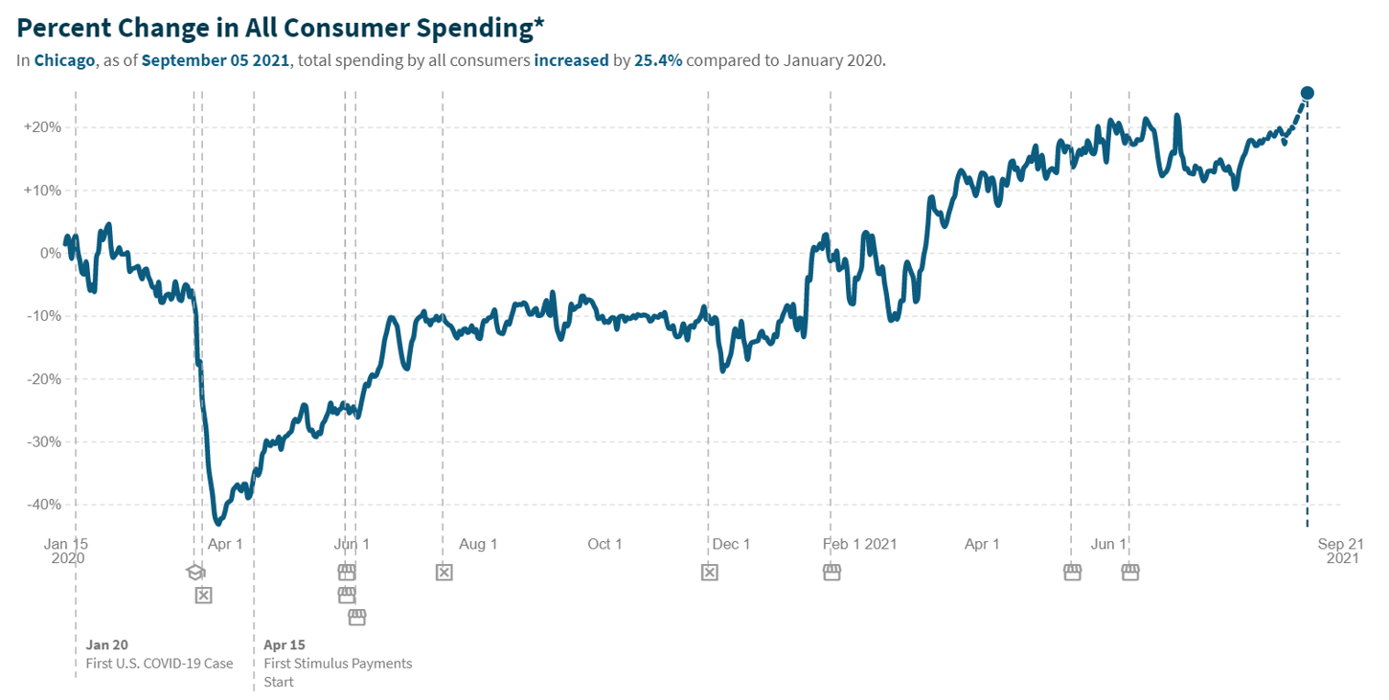
REIA/DePaul Summit Webinar
Change in Consumer Spending in Chicago
Rise in Consumer Spending is Causing Optimism to Overtake Pandemic Concerns
In Chicago, total spending by all consumers increased by 25.4% compared to Jan. 2020
Nearly 6 in 10 CRE professionals are at least optimistic, if not bullish about Chicago real estate for the next 18 months
Back in June, median forecast of real GDP growth in the US was 7%. The September’s forecast is 5.8%.
As supply/demand imbalances have risen, fears of inflation have increased
Source: Tracktherecovery.com
Sept. 23, (Thursday) 2021 Chicago Real Estate: Opportunity Insights

Slide 4
REIA/DePaul Summit Webinar
Commercial Property Price Indices for Chicago
Real Estate Sectors are Recovering at Differing Rates
Pandemic has not caused a paradigm shift for real estate, rather it has accelerated already-present underlying trends
Sectors such as industrial, data centers, self storage, and suburban multifamily are viewed the most favorably and the least likely to encounter future distress
Sectors such as downtown office and indoor retail malls are viewed as the weakest asset class
Global financial crisis
Free fall for all sectors
COVID-19
Winning and losing sectors amplify existing dispersion and show diverse recovery trajectories
Apartments
Industrial
Retail
Office
Hotels
Source: NCREIF
Sept. 23, (Thursday) 2021 Chicago Real Estate: Opportunity Insights

Slide 5
REIA/DePaul Summit Webinar
Real Estate Yields in the Chicago Market
Real Estate Yields have been Relatively Strong and Stable
Real estate managers have the ability to secure long-term leases with contractual rent increases
Should help protect in-place income and embeds future growth
Greatest threats to CRE range from economic conditions put on local and state government, followed by lingering concerns about the potential for financial and economic distress
There is nothing more certain than death, taxes and property uncertainty in Cook County. These concerns aren’t going away.
Retail
Industrial
Office
Apartments
10-yr Treasury Rate
Source: NCREIF, Federal Reserve System, Board of Governors
Sept. 23, (Thursday) 2021 Chicago Real Estate: Opportunity Insights

Slide 6
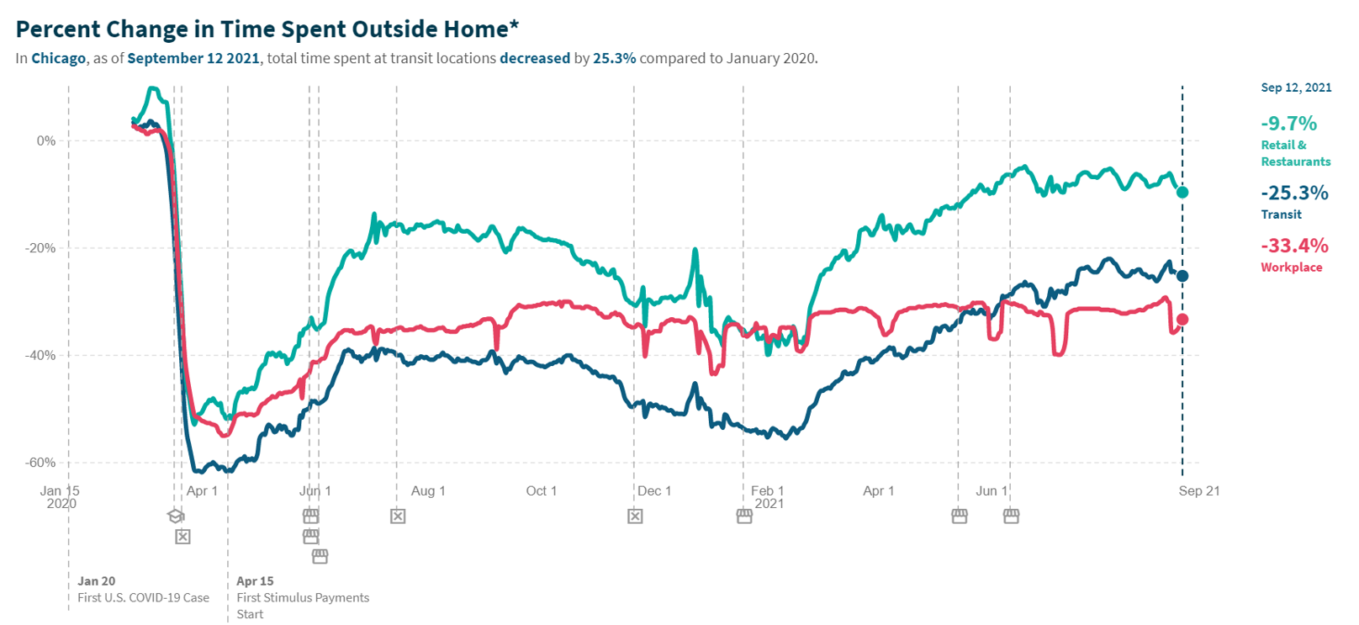
REIA/DePaul Summit Webinar
Shift to Work-from-Home is Inescapable
But the Forces that Led to an Urban Economic Rebirth since 1990
have not Vanished
Time Spent Outside Home
Total time spent at transit locations decreased by 25.3% compared to Jan. 2020
Total time spent at workplace decreased by 33.4% compared to Jan. 2020
Total time spent at retail & restaurants decreased by 9.7% compared to Jan. 2020.
It’s unlikely, however, that the pandemic will end the urban renaissance that many cities have experienced since 1990.
Source: Tracktherecovery.com, Google Community Mobility Reports
Sept. 23, (Thursday) 2021 Chicago Real Estate: Opportunity Insights

