Slide 1
Fourteenth Annual REIA/DePaul Summit
A Mid-Year Perspective on
Chicago Real Estate Market
September 27, 2108
James D. Shilling
DePaul University
Professor and George R. Ruff Chair
in Real Estate Studies

Slide 2
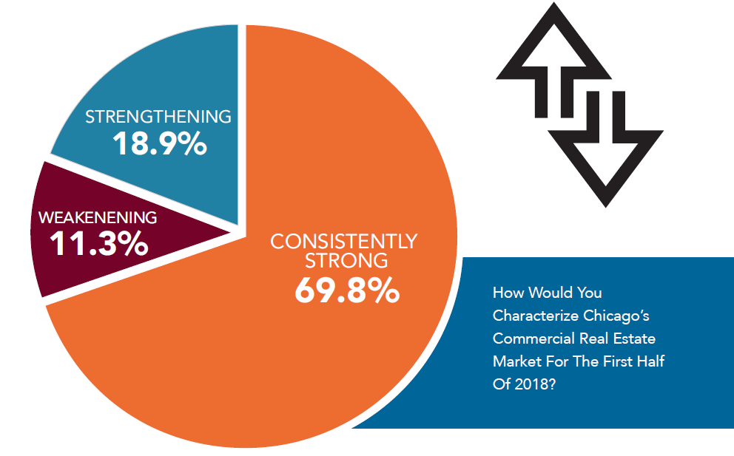
Fourteenth Annual REIA/DePaul Summit
Chicago Real Estate Markets at a Glance
CRE Markets Consistently Strong in 1H2018 …
Source: Mid-Year Chicago CRE Survey conducted by The Real Estate Center at DePaul

Slide 3
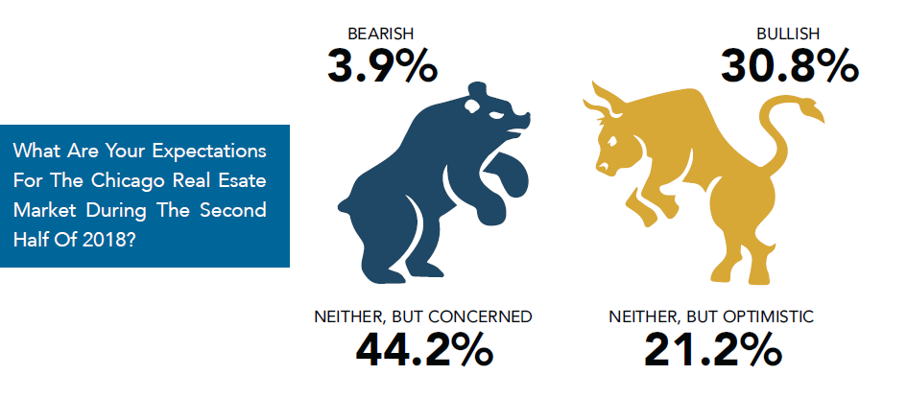
Fourteenth Annual REIA/DePaul Summit
Chicago Real Estate Markets at a Glance
Mixed Sentiment Looking Forward …
Source: Mid-Year Chicago CRE Survey conducted by The Real Estate Center at DePaul

Slide 4
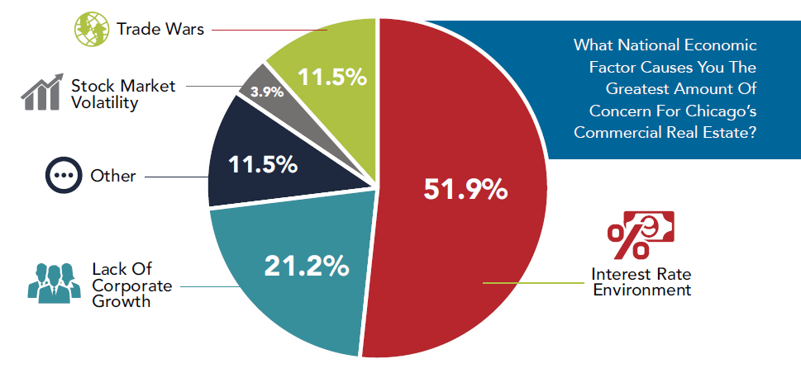
Fourteenth Annual REIA/DePaul Summit
Chicago Real Estate Markets at a Glance
Structural Headwinds that Could Slow the CRE Market …
Source: Mid-Year Chicago CRE Survey conducted by The Real Estate Center at DePaul

Slide 5
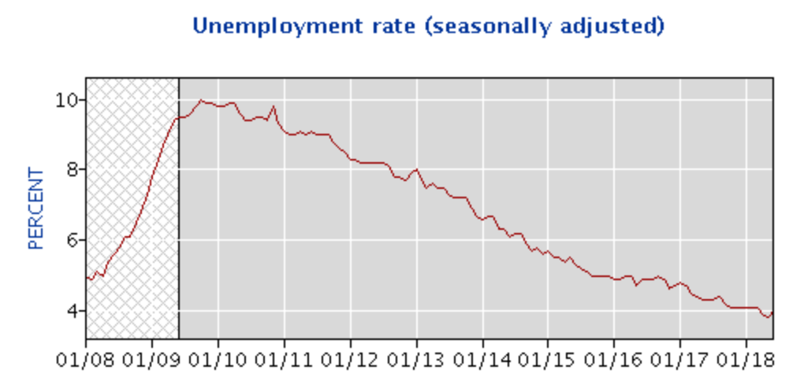
Fourteenth Annual REIA/DePaul Summit
Chicago Real Estate Markets at a Glance
A Strong US Labor Market is a Reason to Feel Optimistic …
Unemployment Rate is Below 4% …
Fueling Strong Wage and Income Growth
Source: Bureau of Labor Statistics

Slide 6
Fourteenth Annual REIA/DePaul Summit
Chicago Real Estate Markets at a Glance
Observed CRE Cap Rate Spread over 10-yr Treasury since 1978 …
Ave. CRE Cap Rate Spread over 10-yr Treasury during Business Cycles (in basis points)
 | Contractions | Expansions
1990s | 409 | 85
2000s | 330 | 281
Source: NCREIF, Fed Reserve Economic Data, and National Bureau of Economic Research

Slide 7
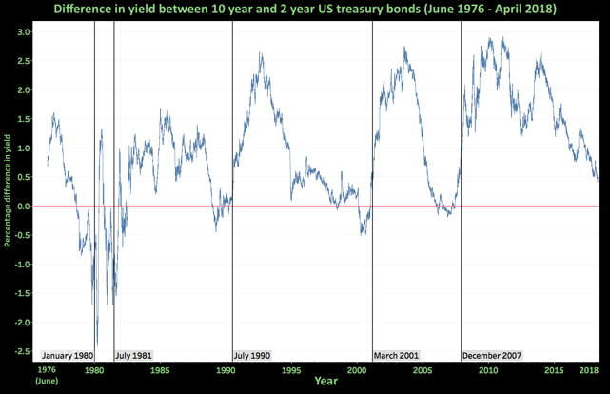
Fourteenth Annual REIA/DePaul Summit
Chicago Real Estate Markets at a Glance
What Information Does the Yield Curve Yield? …
Note: Vertical lines indicate start of a recession.
An inverted yield curve has in the past proven to be a strong indicator of an oncoming recession.
Source: Fed Reserve Economic Data and National Bureau of Economic Research

