Slide 1
Fifteenth Annual REIA/DePaul Summit
A Mid-Year Perspective on
Chicago Real Estate Market
September 19, 2109
James D. Shilling
DePaul University
Professor and George R. Ruff Chair
in Real Estate Studies

Slide 2
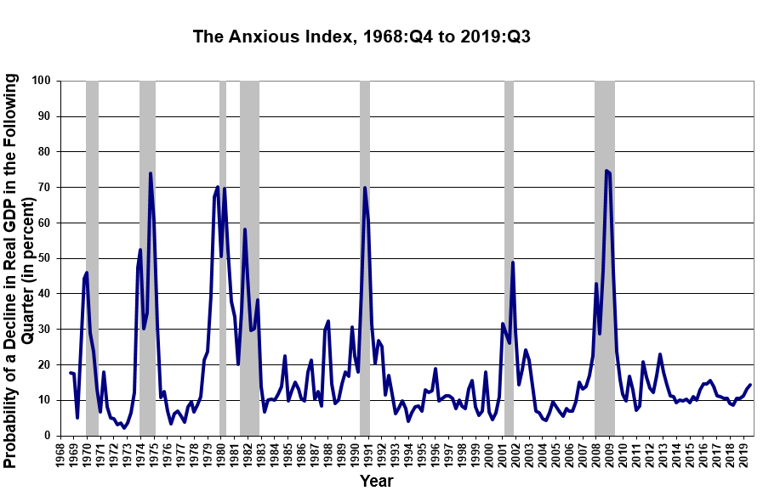
Fifteenth Annual REIA/DePaul Summit
We’re Low on the Anxious Index
Source: Federal Reserve Bank of Philadelphia

Slide 3
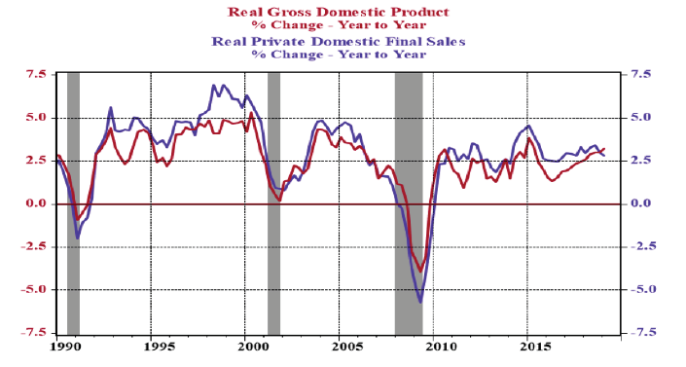
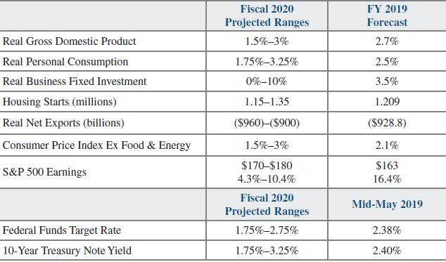
Fifteenth Annual REIA/DePaul Summit
Economy Appears to be Moderating – No Recession Yet
US Economic Growth US Forecast in Brief
Growth Rate in Real GDP (in percent)
Growth Rate in Real Private Domestic Final Sales (in percent)
Source: Bureau of Economic Analysis, World Economic Outlook, IMF

Slide 4
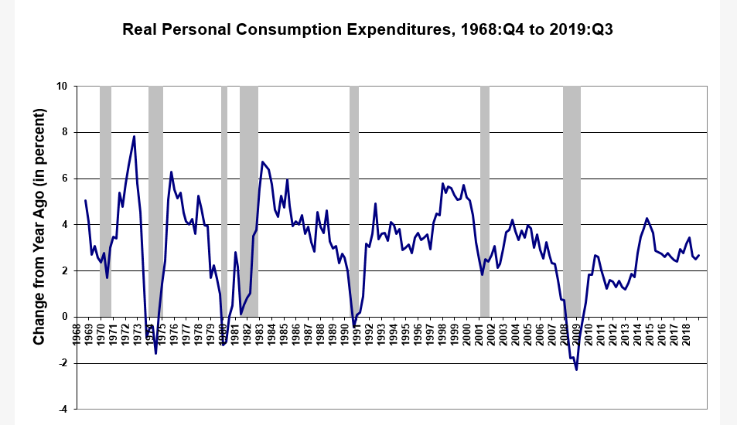
Fifteenth Annual REIA/DePaul Summit
Solid Consumer Spending from a Nearly Fully
Employed Workforce
Some bright spots:
Consumers feel well
Unemployment remains low
Supporting income growth
is strong (including that in
low-wage industries)
Lower mortgage rates have
kicked off a wave of
refinancings
Source: Bureau of Economic Analysis

Slide 5
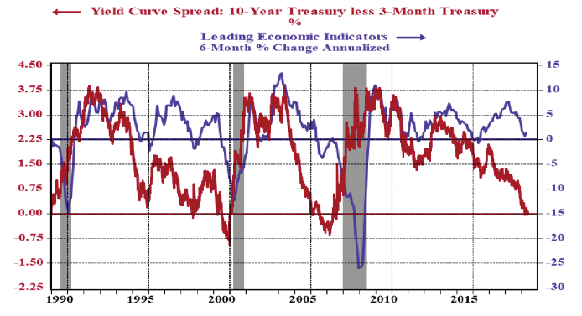
Fifteenth Annual REIA/DePaul Summit
Inverted Yield Curve has Returned
Curve might not be signaling a looming downturn. Many factors
may be pushing down long-term yields
Yield Curve Spread (in percent)
LEI Index
1. LEI is an amalgam of average weekly hours, manufacturers’ new orders, building permits, stock prices, interest rate spread, leading credit index, consumer expectations
Source: FRB, Conference Board Leading Economic Index (LEI)

Slide 6
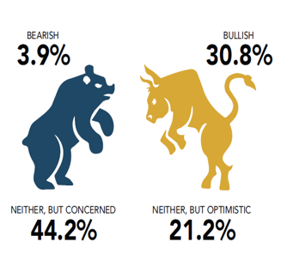
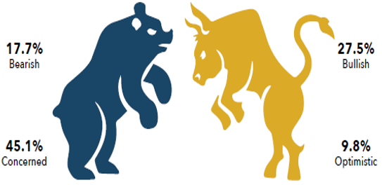
Fifteenth Annual REIA/DePaul Summit
Investors in Chicago are Becoming More Bearish
Bears now outweigh the bulls …
Expectations for the Chicago Market during the Second Half of the Year?
2018 2019
48% | 52% |  | 63% | 37%
Bearish Bullish Bearish Bullish
Source: Mid-Year Chicago CRE Survey conducted by The Real Estate Center at DePaul, 2018 and 2019

Slide 7
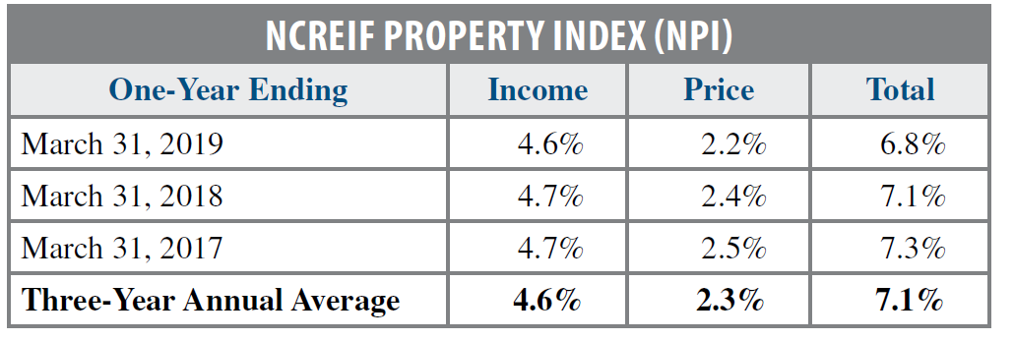
Fifteenth Annual REIA/DePaul Summit
Look for a Slowdown in Trading and Less
Change in Real Estate Prices
Total US Commercial Real Estate Transaction Volume
Transaction Volume (in millions $)
Anticipated Returns Ought to be At to Slightly Below Normal
Source: Real Capital Analytics (RCA), NCREIF

Slide 8
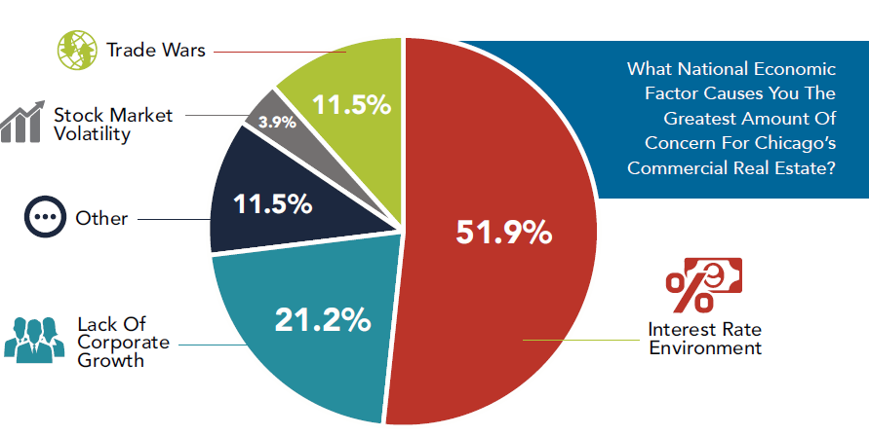
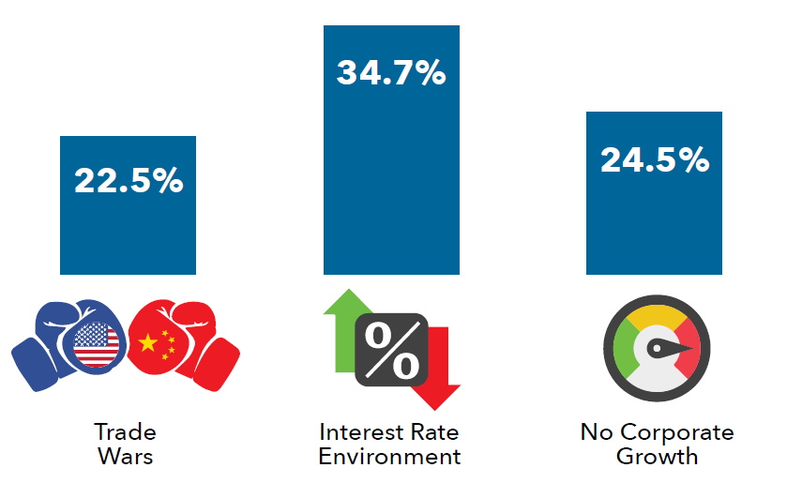
Fifteenth Annual REIA/DePaul Summit
Concerns are Rising Over a Slowdown in
Corporate Revenues and Profits
National Factors Impacting Activity
2018 2019
Source: Mid-Year Chicago CRE Survey conducted by The Real Estate Center at DePaul, 2018 and 2019

Slide 9
Fifteenth Annual REIA/DePaul Summit
Changing Sentiment in the Broader Market will
Positively Affect the Relative Attractiveness of REITs
Together with lower interest rates look for REIT prices to increase
Premium/Discount to NAV for Office REITs
Premium/Discount to NAV (in percent)
Source: S&P Global Market Intelligence

Slide 10
Fifteenth Annual REIA/DePaul Summit
Key Takeaways

Slide 11
Fifteenth Annual REIA/DePaul Summit
Key Takeaways
  Is it time to be extremely defensive about the market? No.
  Real estate fundamentals are solid for most property types, but potential price appreciation is limited and is unlikely to pick up as the real estate cycle matures and as “bulls become bears.”
  For publicly-traded REITs, expect lower but positive corporate earnings growth in the broader market (changing market sentiment) to generate returns that are at-to-above normal. Rising prices will slow public-to-private transactions.

