Slide 1
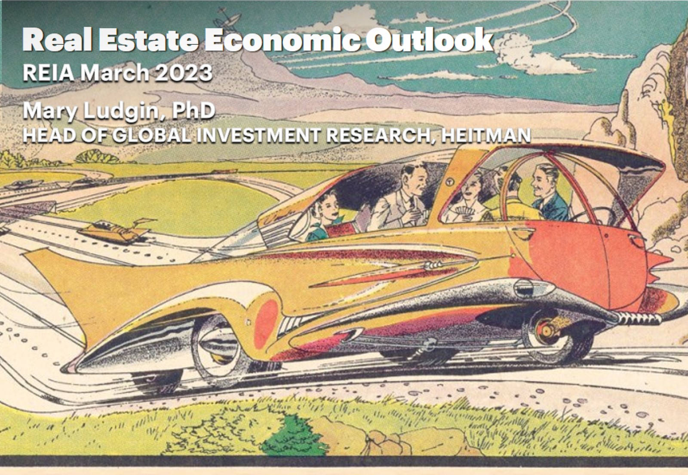

Slide 2
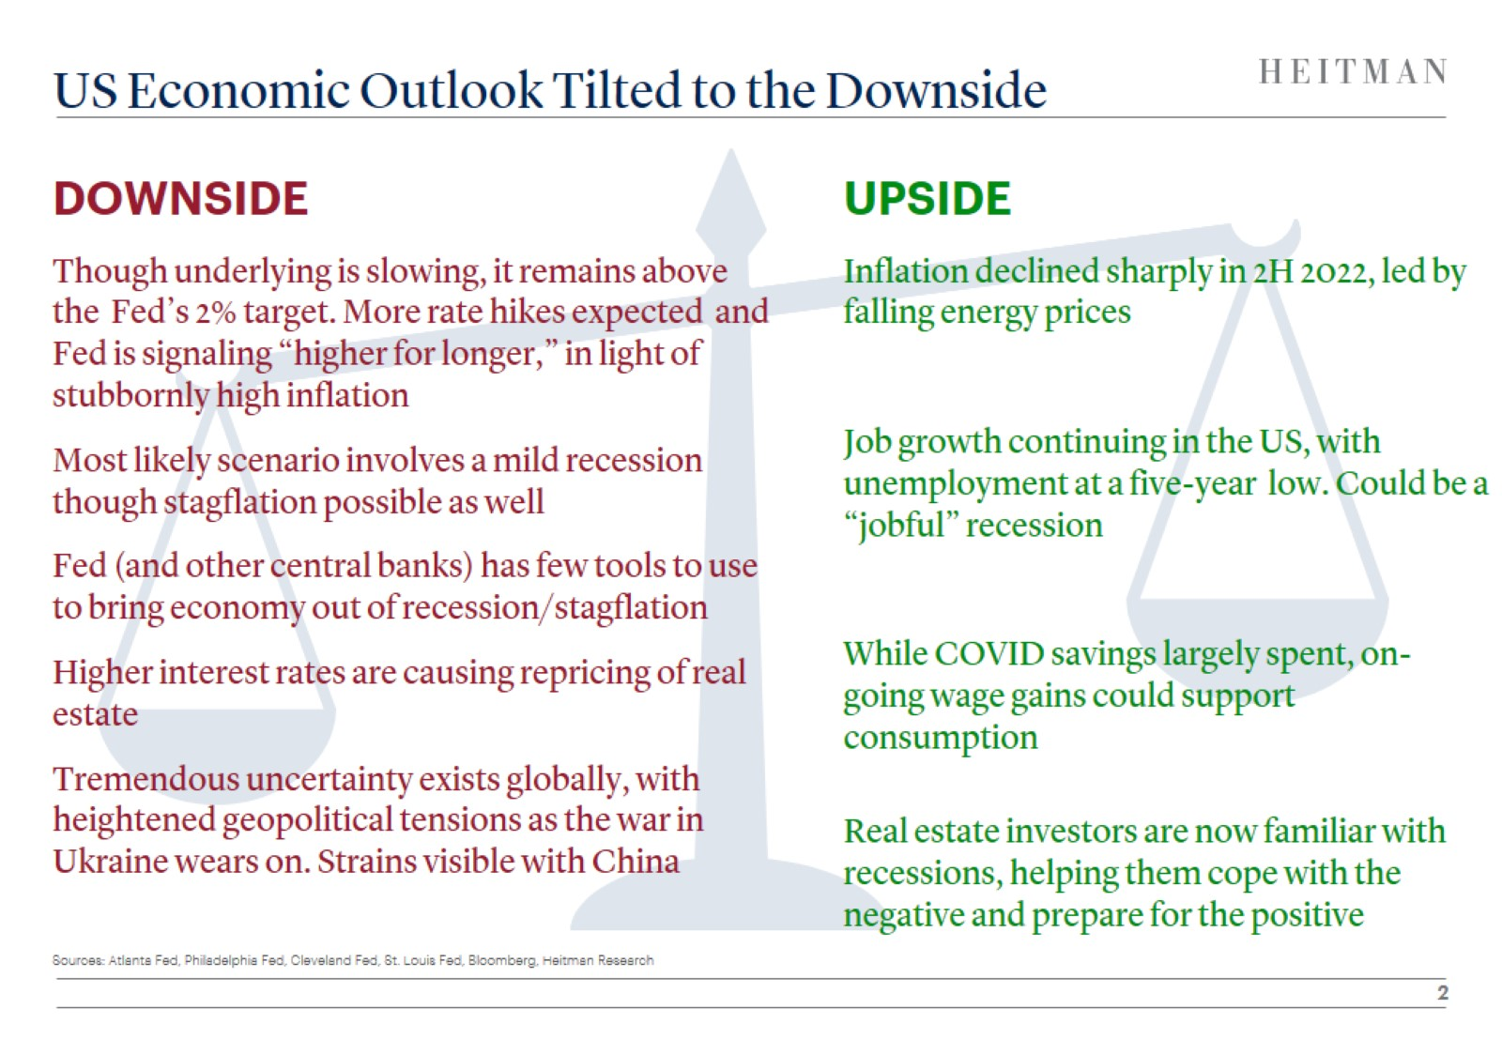
US Economic Outlook Tilted to the Downside

Slide 3
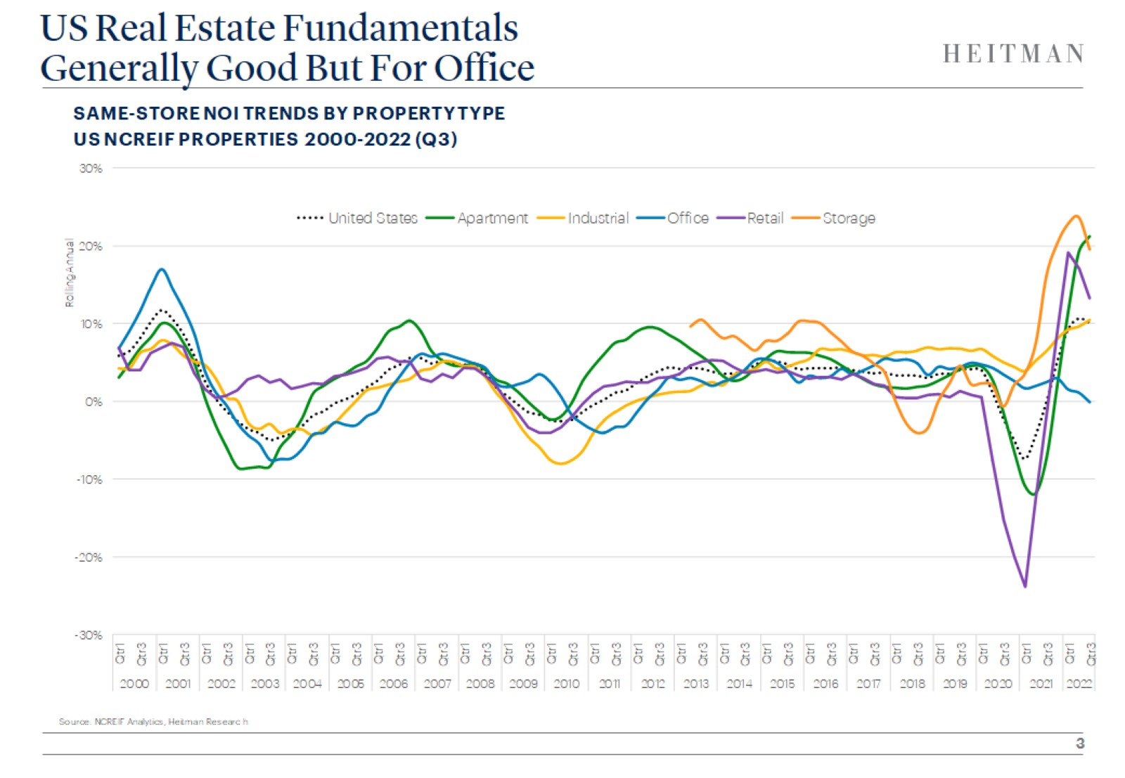
US Real Estate Fundamentals
Generally Good But For Office

Slide 4
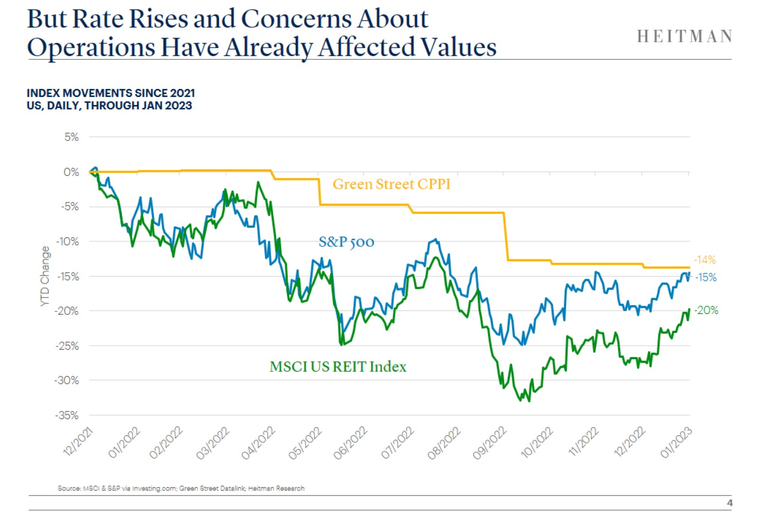
But Rate Rises and Concerns About
Operations Have Already Affected Values

Slide 5
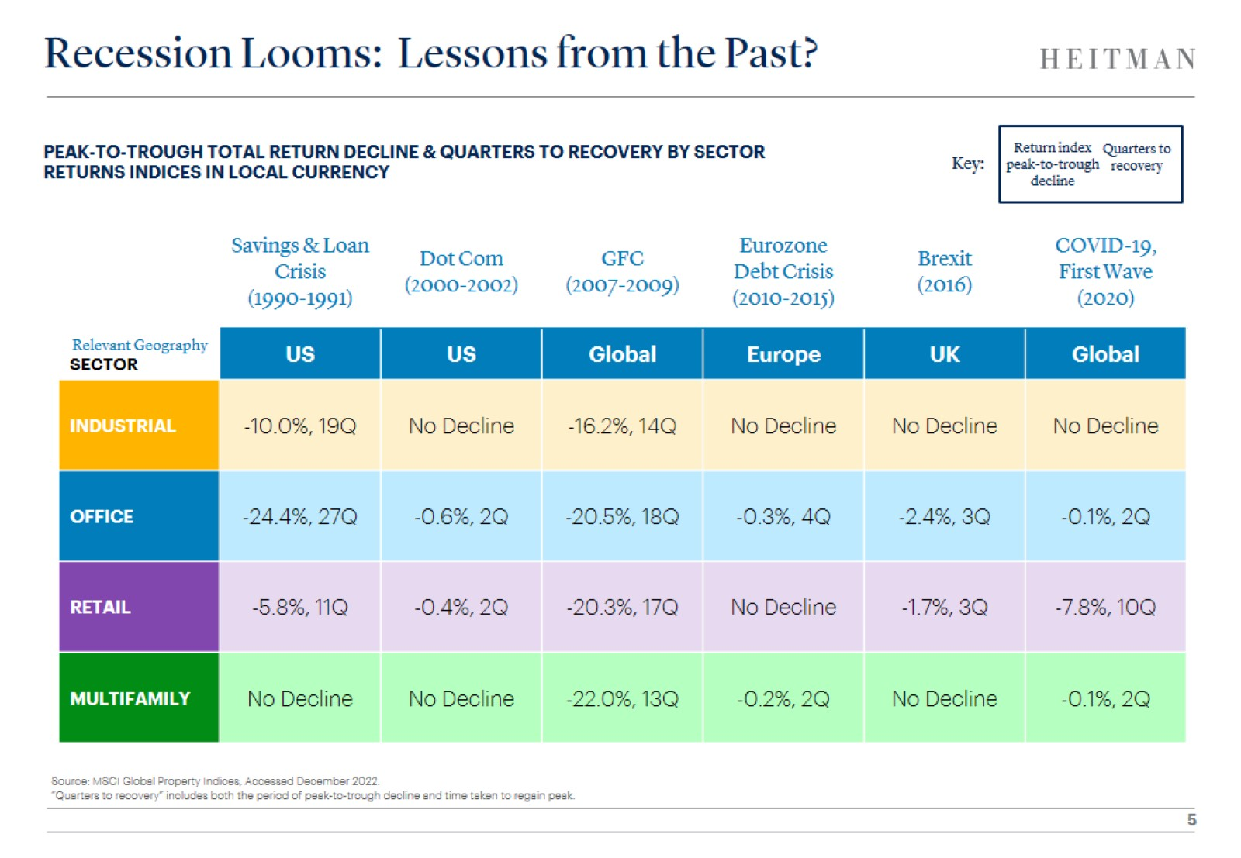
Recession Looms: Lessons from the Past?

Slide 6
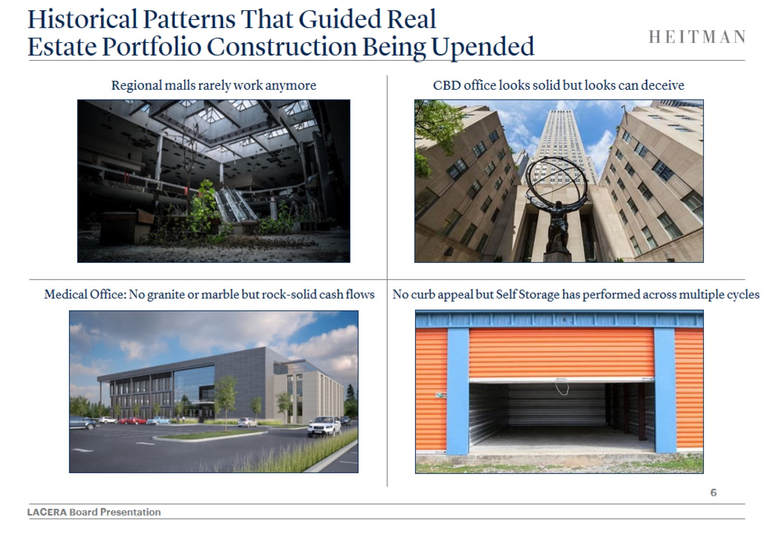
Historical Patterns That Guided Real
Estate Portfolio Construction Being Upended

Slide 7
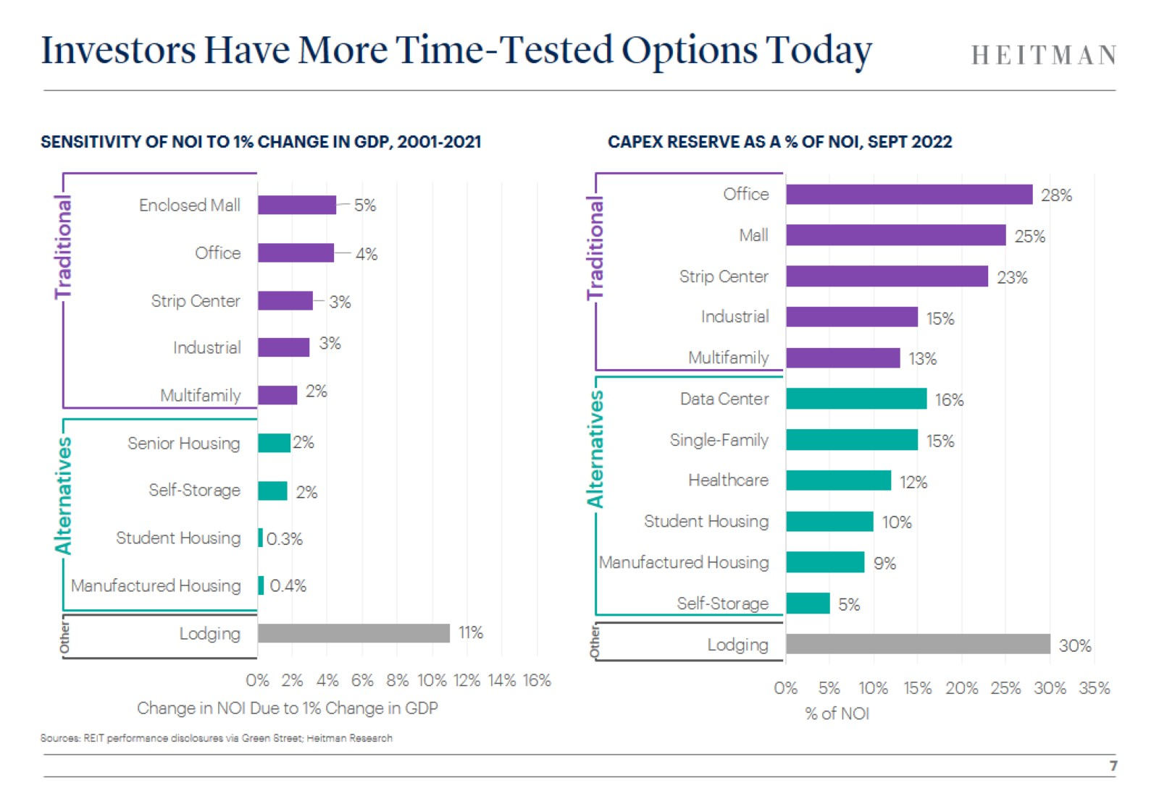
Investors Have More Time-Tested Options Today

Slide 8

Short-Term Lease Sectors Playing
Increasing Role in Institutional Real Estate Portfolios

Slide 9
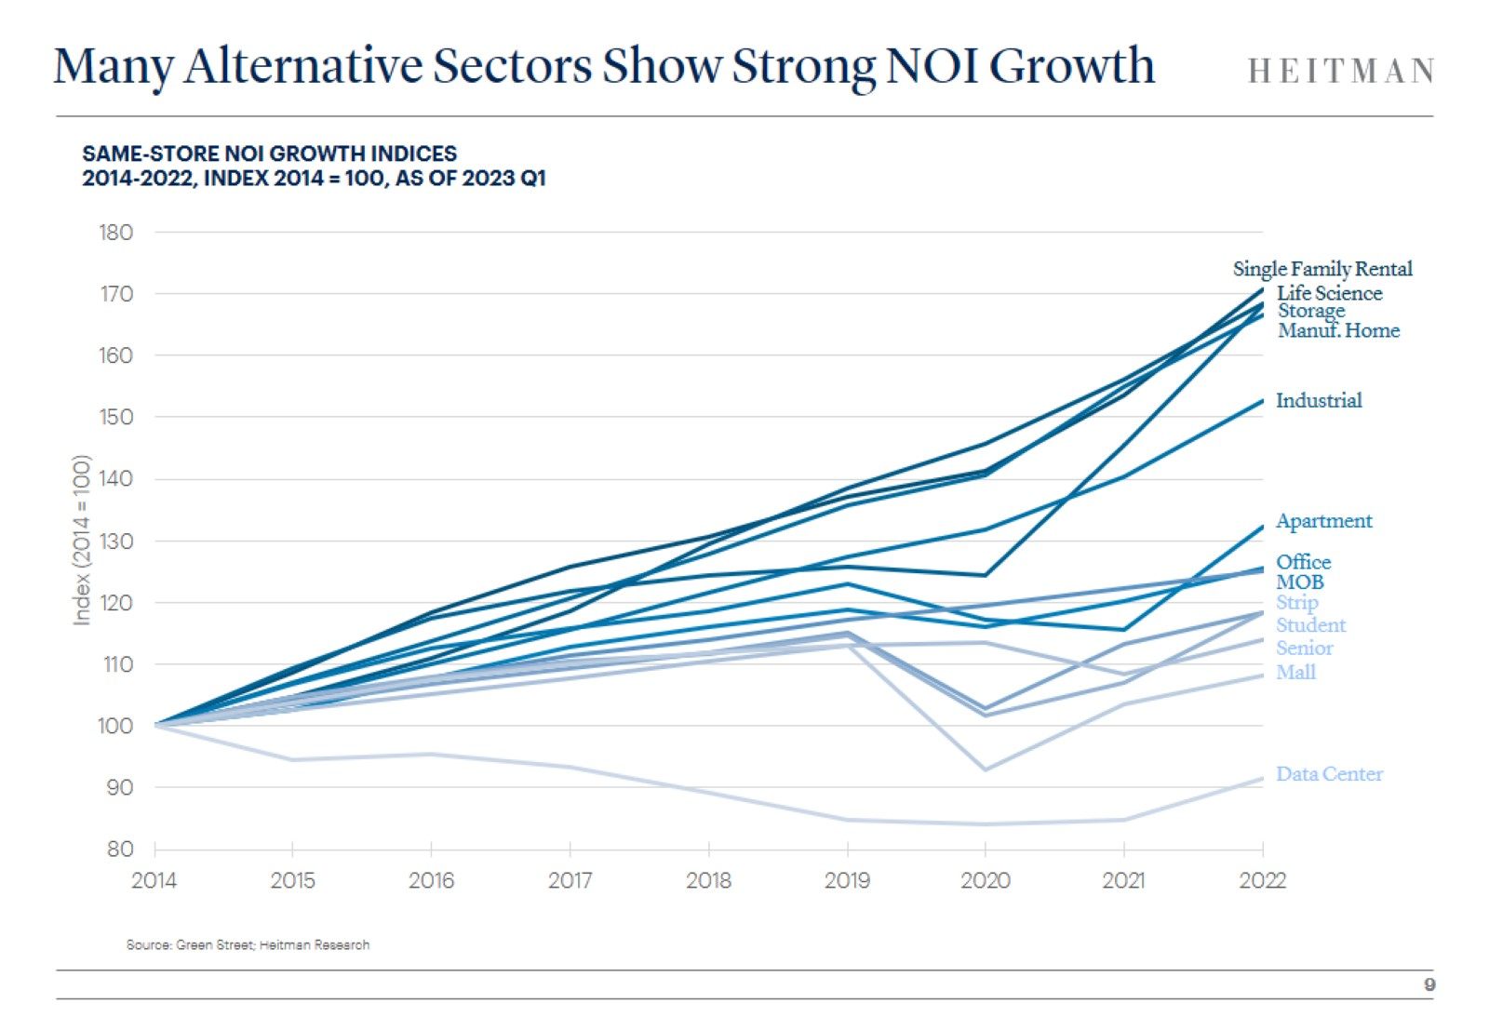

Slide 10
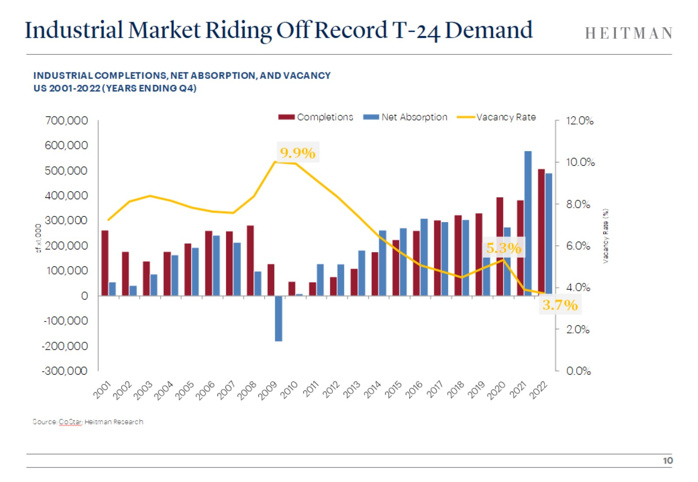
Industrial Market Riding Off Record T-24 Demand

Slide 11
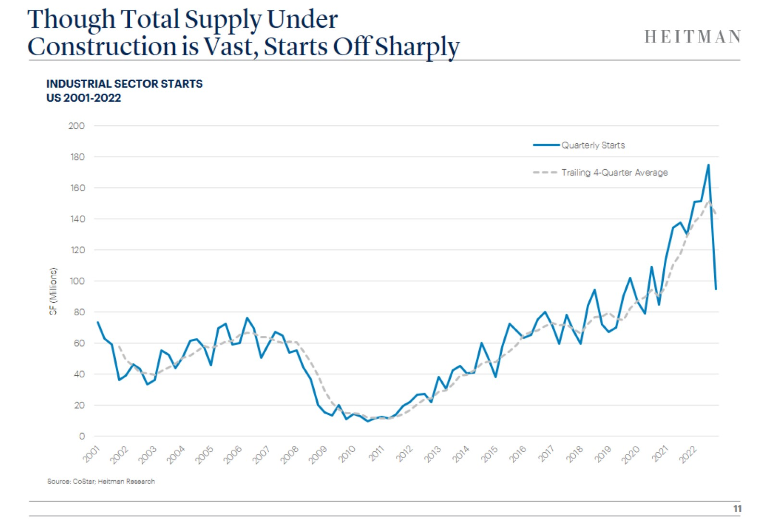
Though Total Supply Under
Construction is Vast, Starts Off Sharply

Slide 12
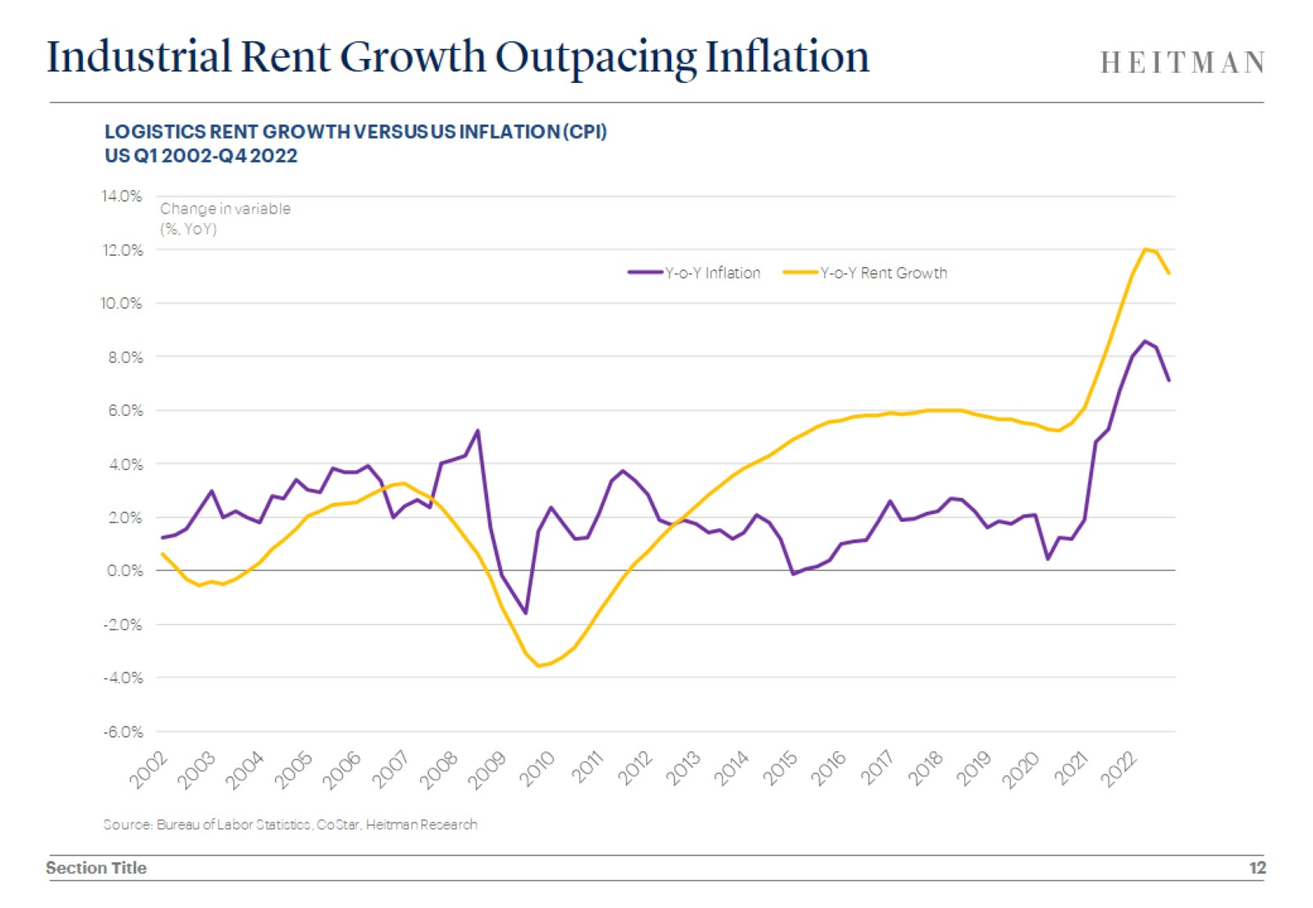
Industrial Rent Growth Outpacing Inflation

Slide 13
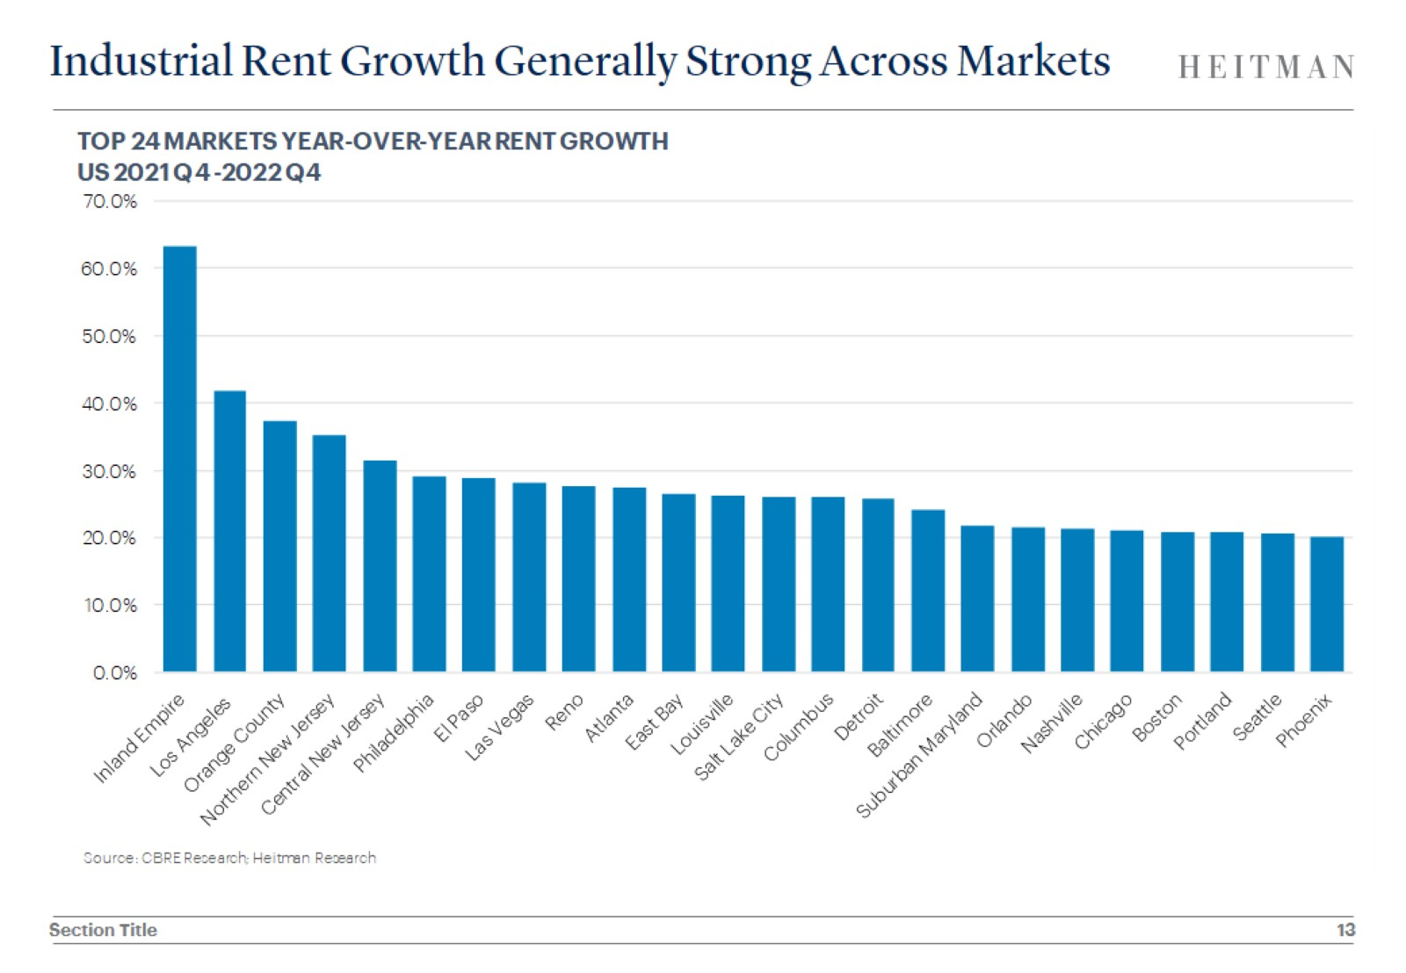
Industrial Rent Growth Generally Strong Across Markets

Slide 14
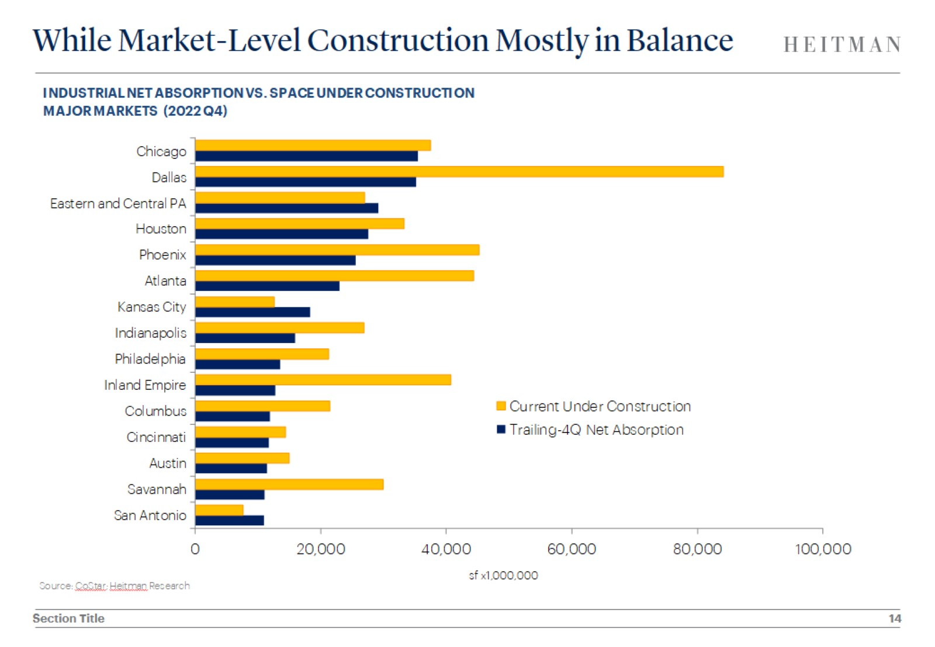
While Market-Level Construction Mostly in Balance

Slide 15
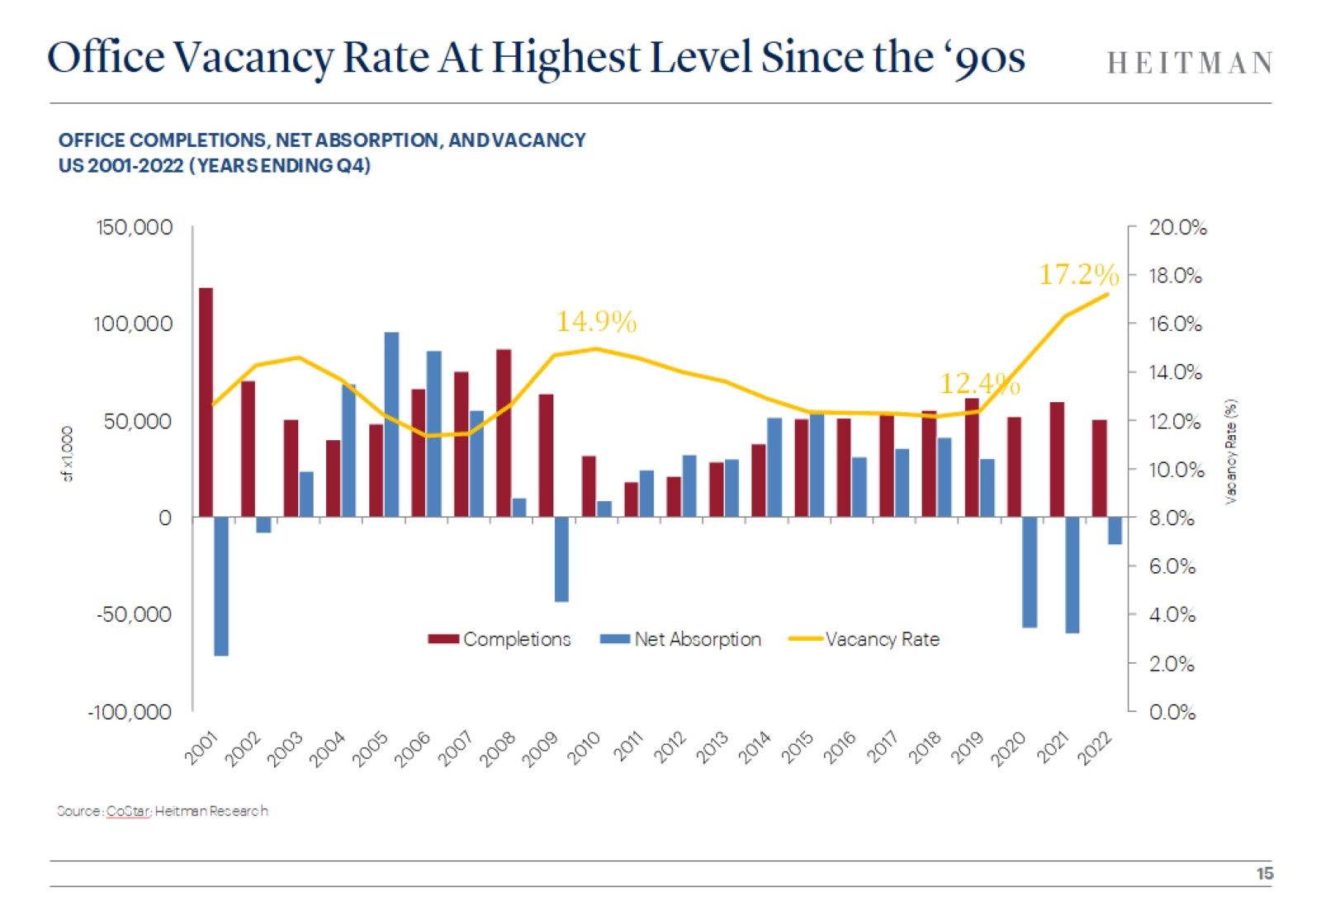
Office Vacancy Rate At Highest Level Since the ‘90s

Slide 16
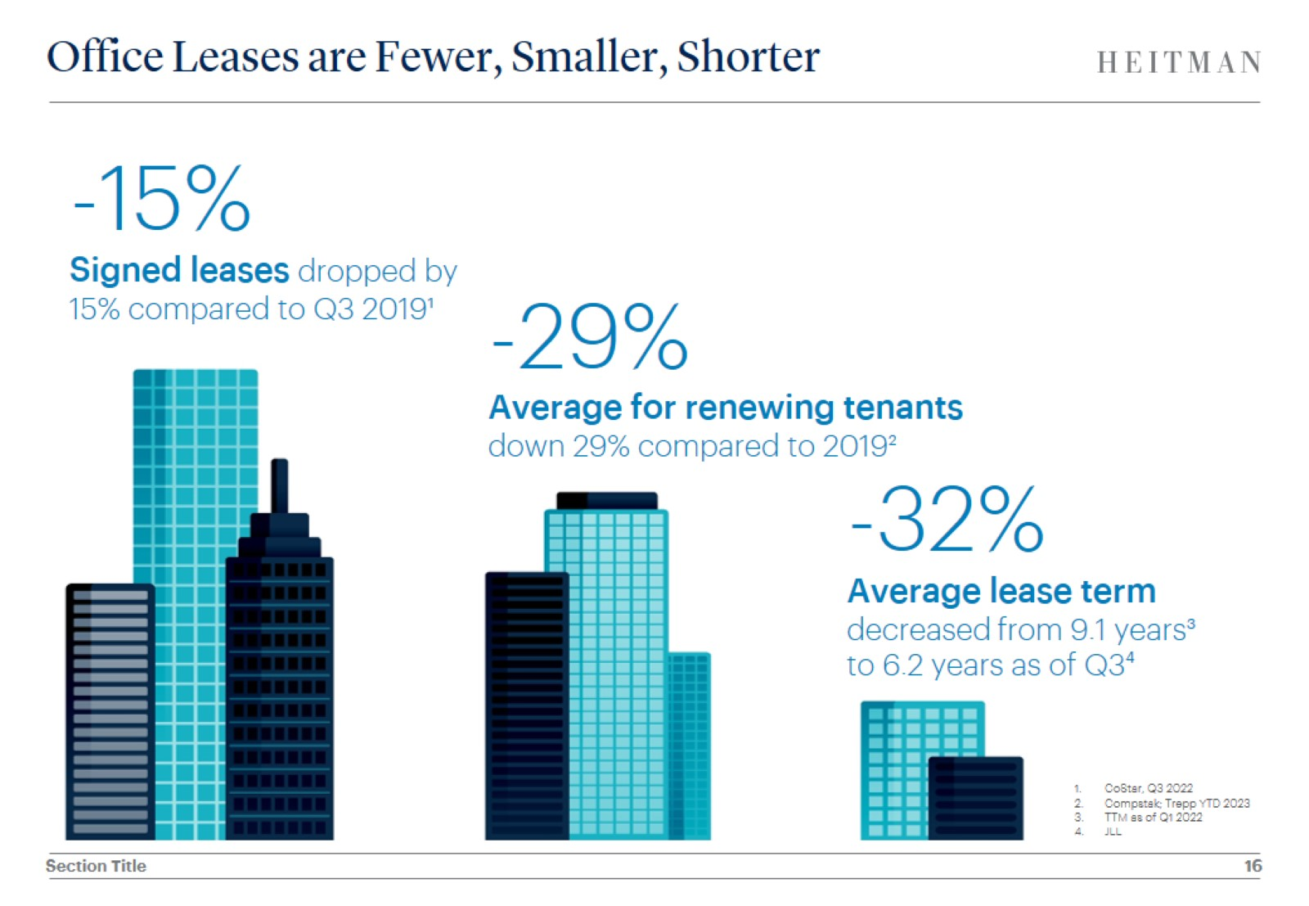
Office Leases are Fewer, Smaller, Shorter

Slide 17
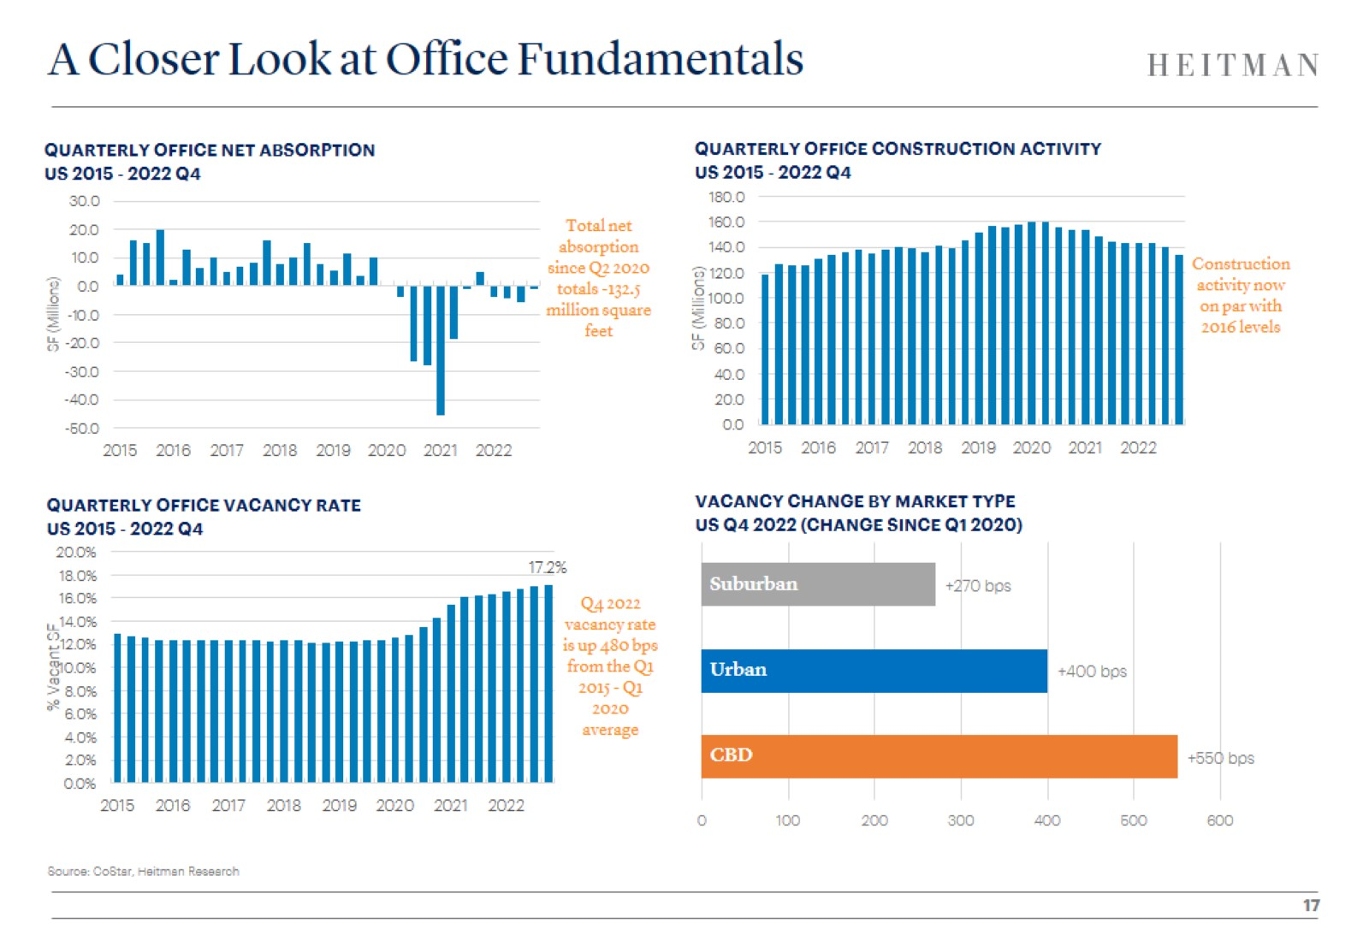
A Closer Look at Office Fundamentals

Slide 18
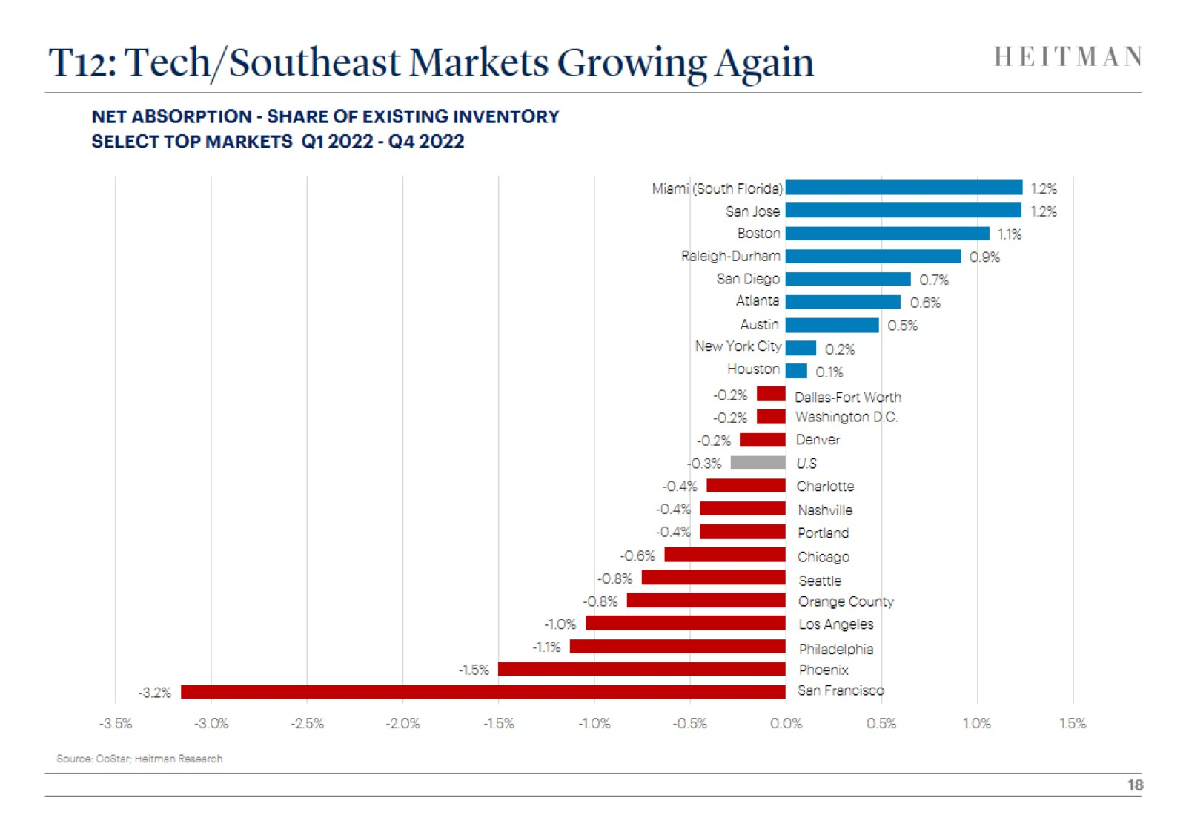
T12: Tech/Southeast Markets Growing Again

Slide 19
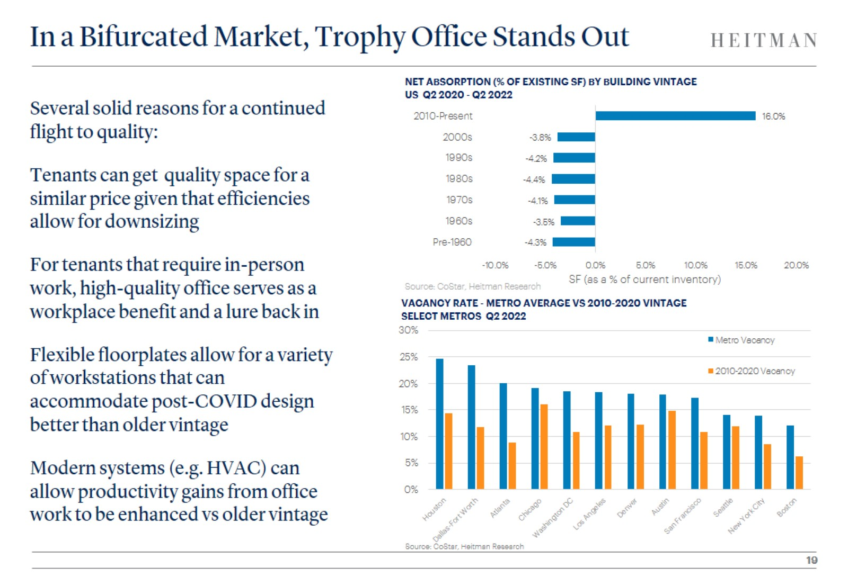
In a Bifurcated Market, Trophy Office Stands Out

Slide 20
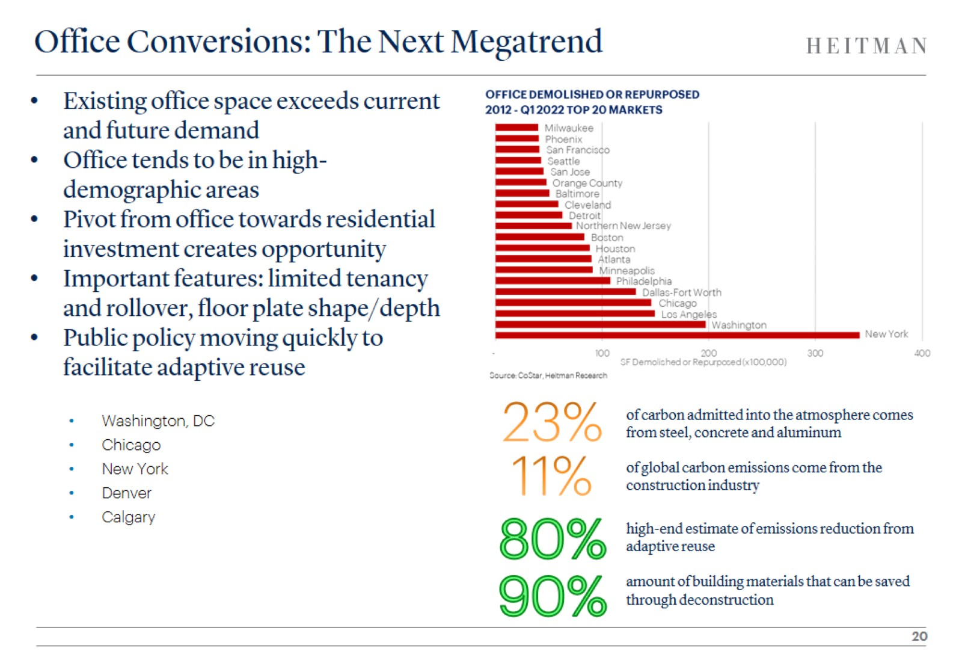
Office Conversions: The Next Megatrend

Slide 21
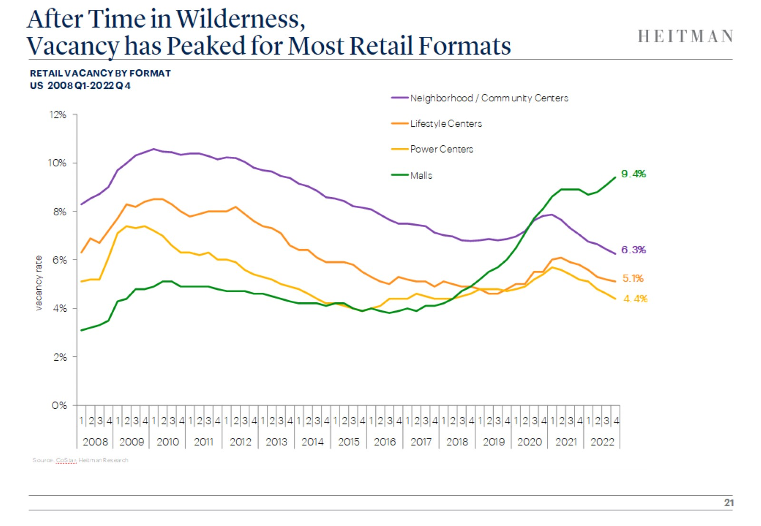
After Time in Wilderness,
Vacancy has Peaked for Most Retail Formats

Slide 22
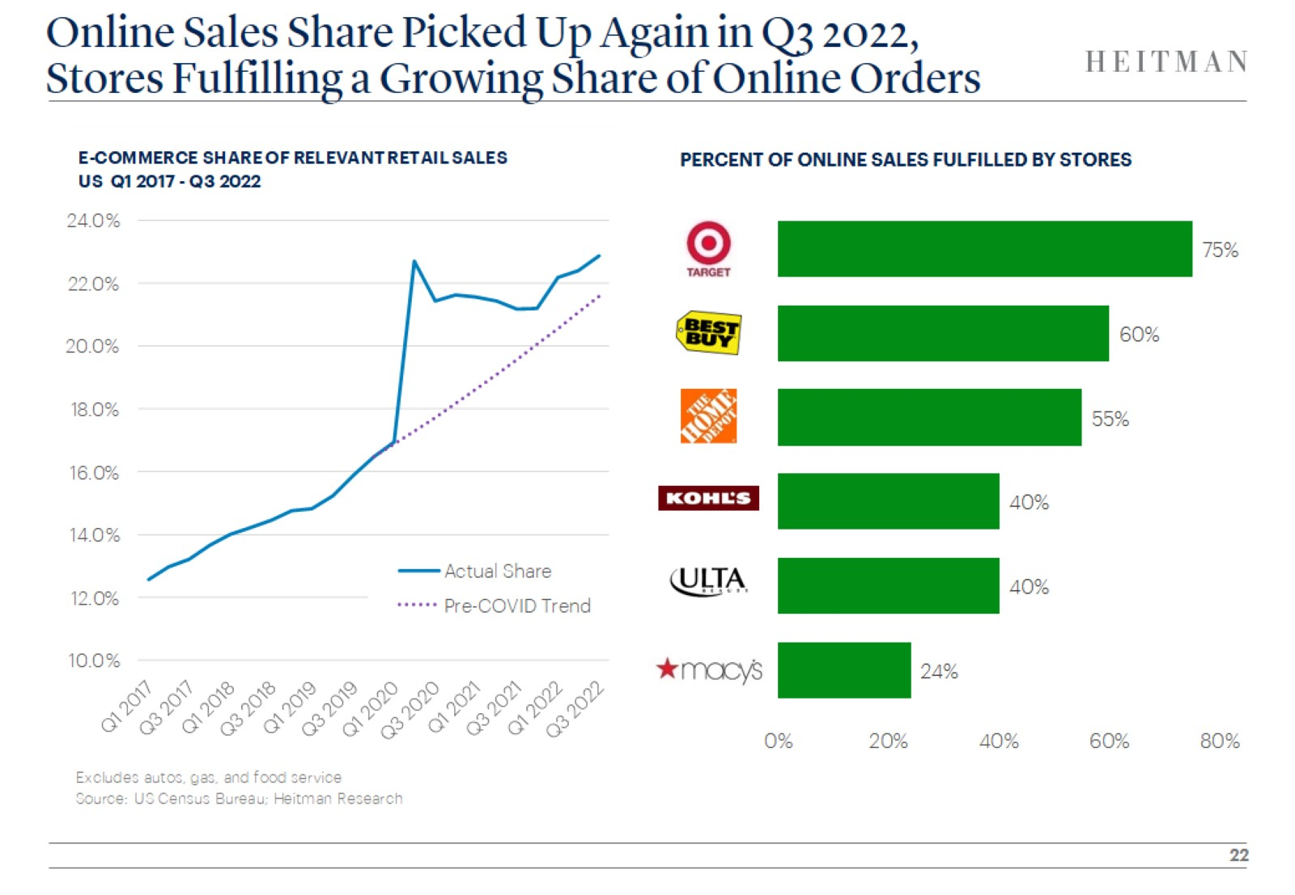
Online Sales Share Picked Up Again in Q3 2022,
Stores Fulfilling a Growing Share of Online Orders

Slide 23
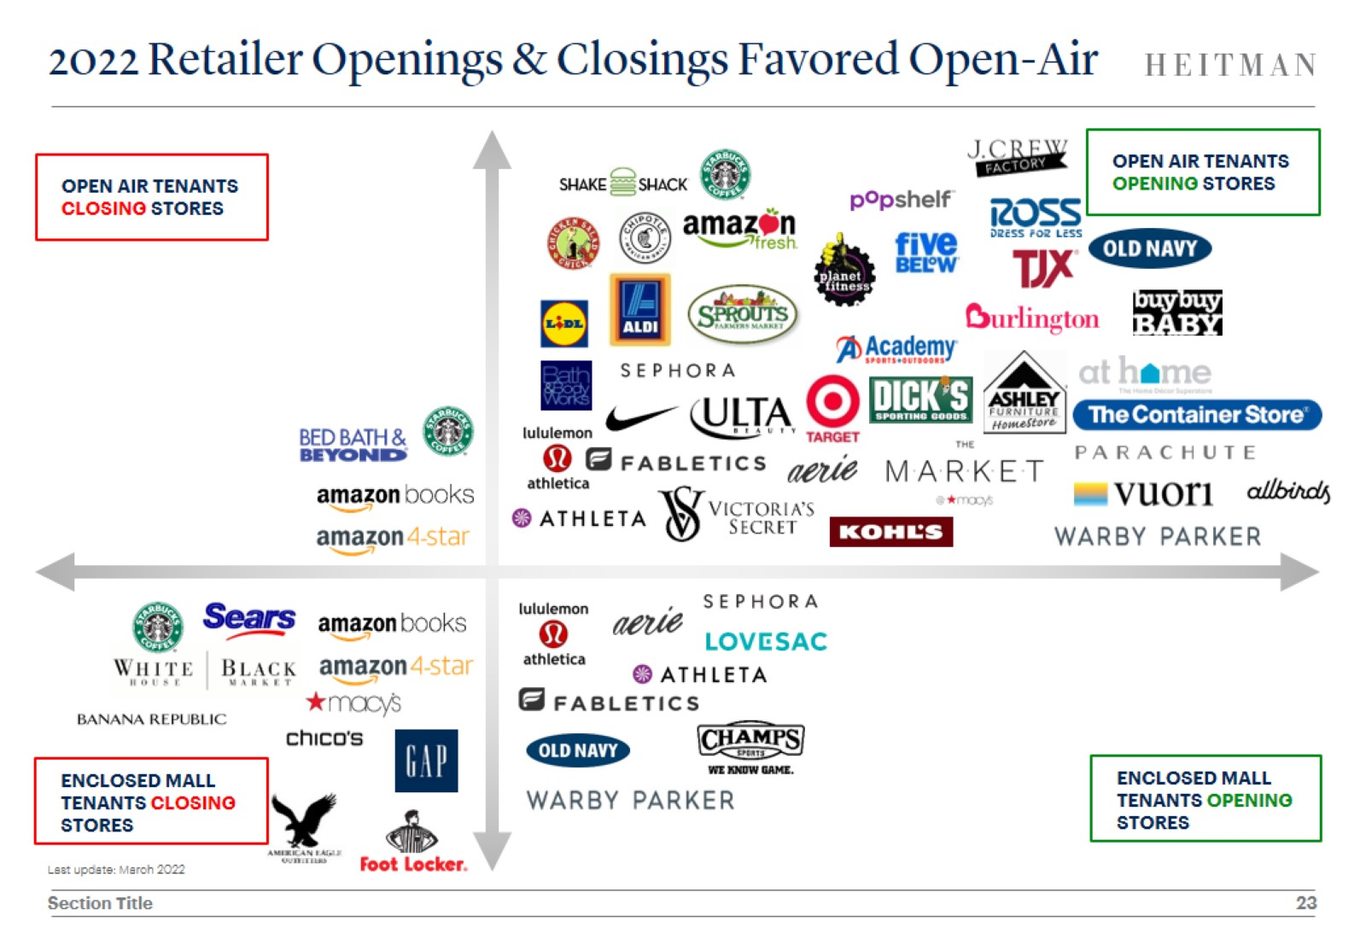
2022 Retailer Openings & Closings Favored Open-Air

Slide 24
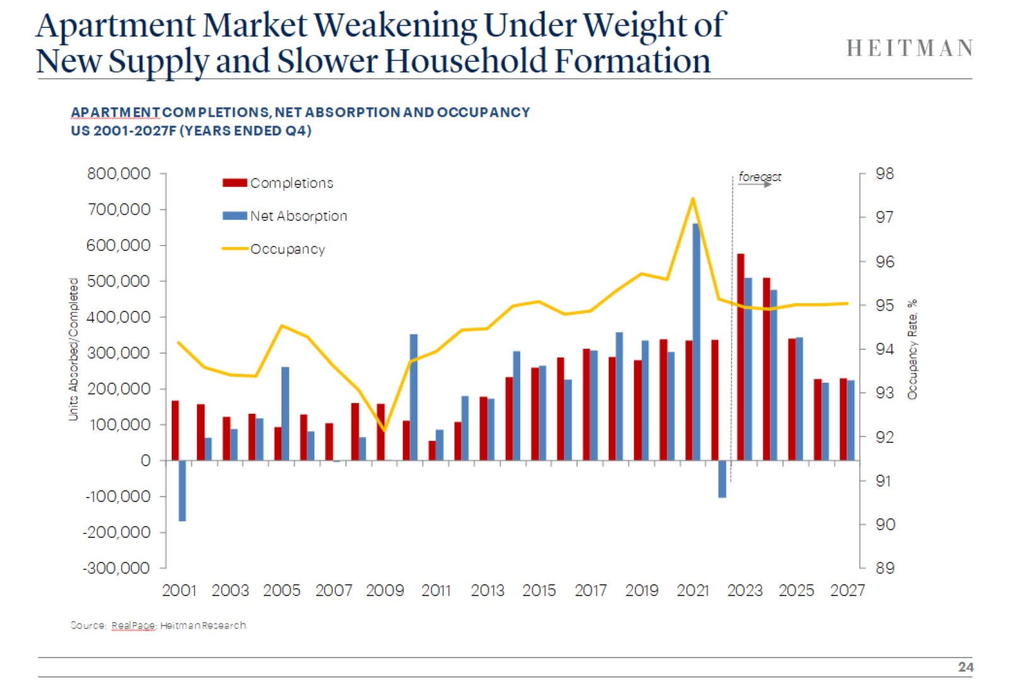
Apartment Market Weakening Under Weight of
New Supply and Slower Household Formation

Slide 25
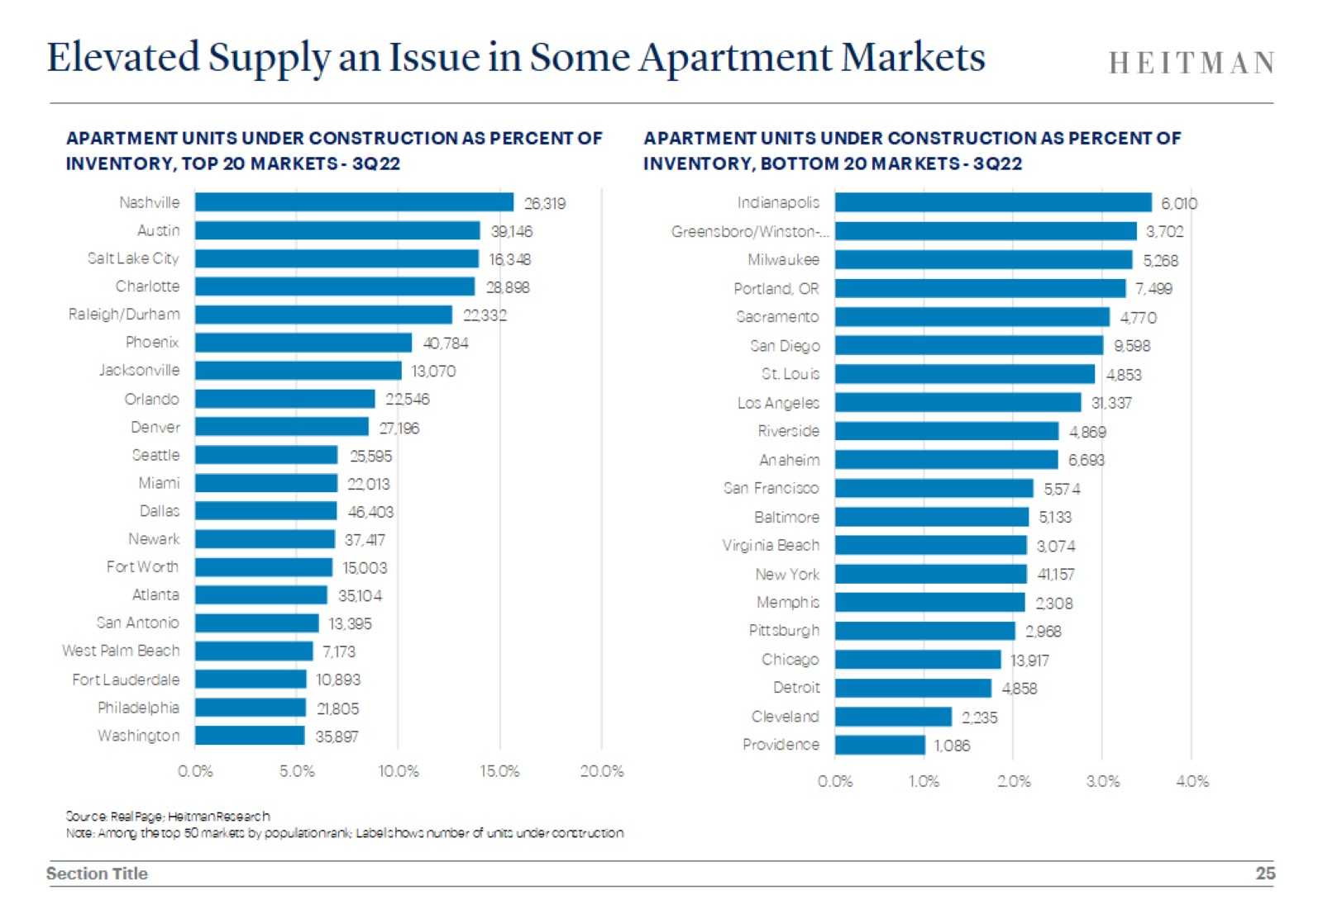
Elevated Supply an Issue in Some Apartment Markets

Slide 26
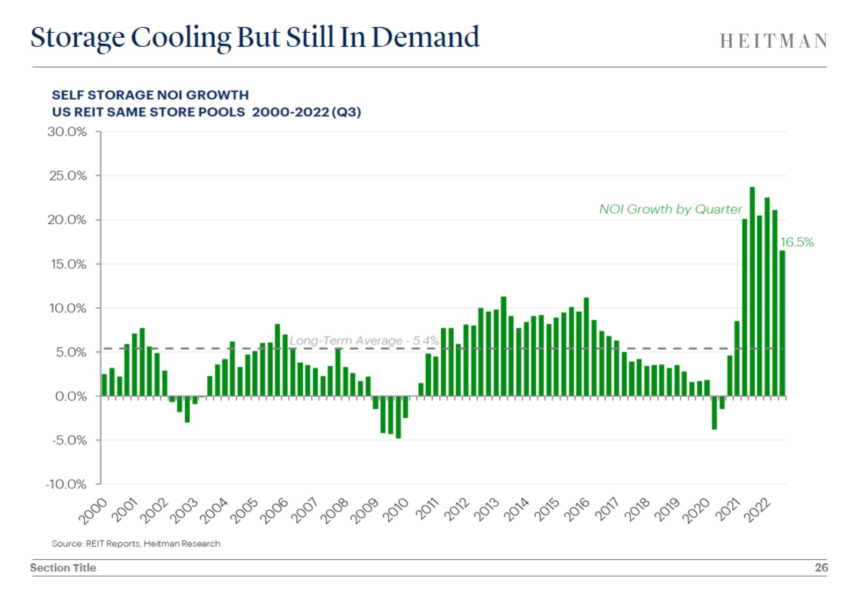
Storage Cooling But Still In Demand

Slide 27
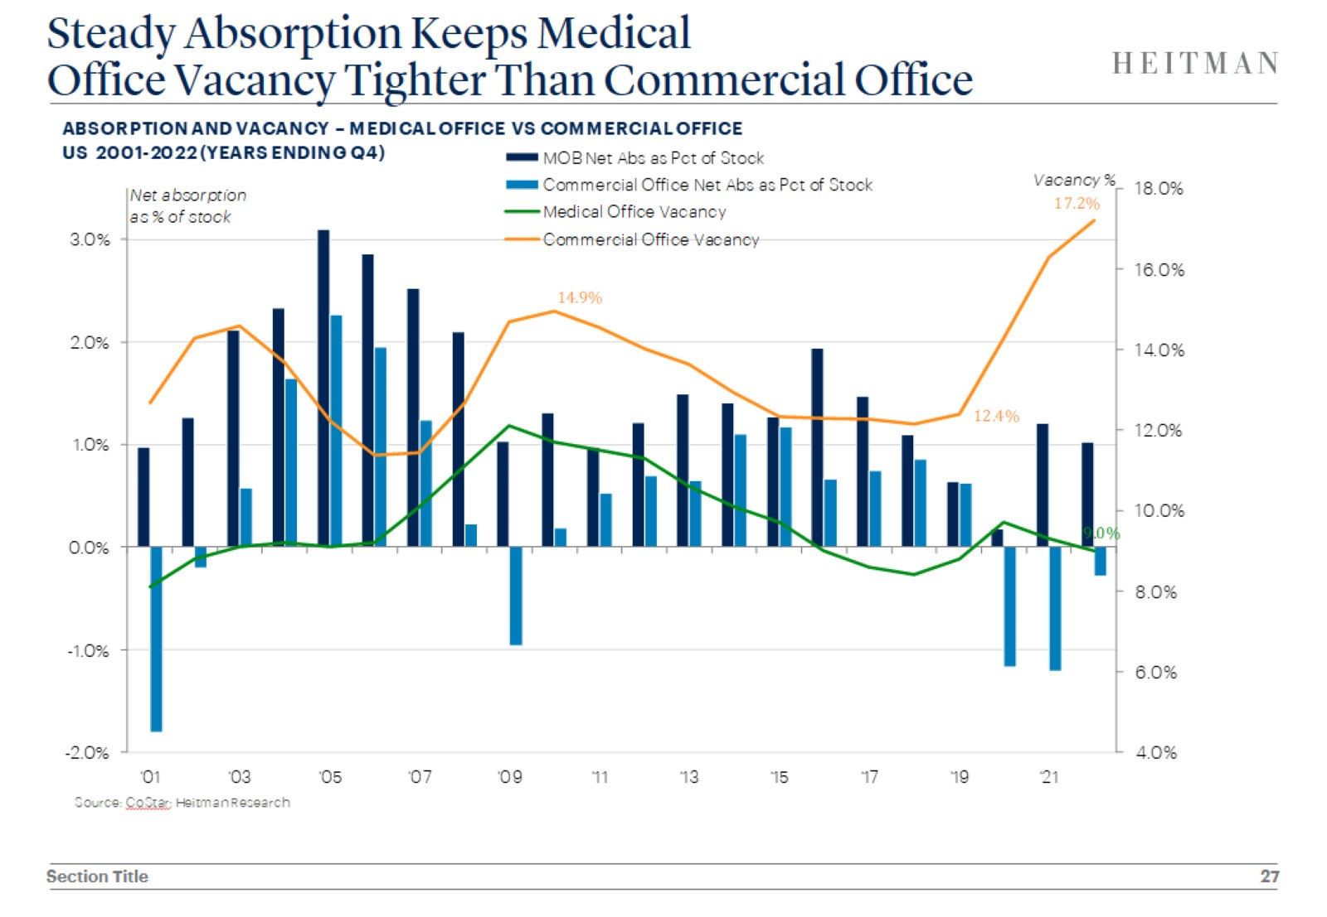
Steady Absorption Keeps Medical
Office Vacancy Tighter Than Commercial Office

Slide 28
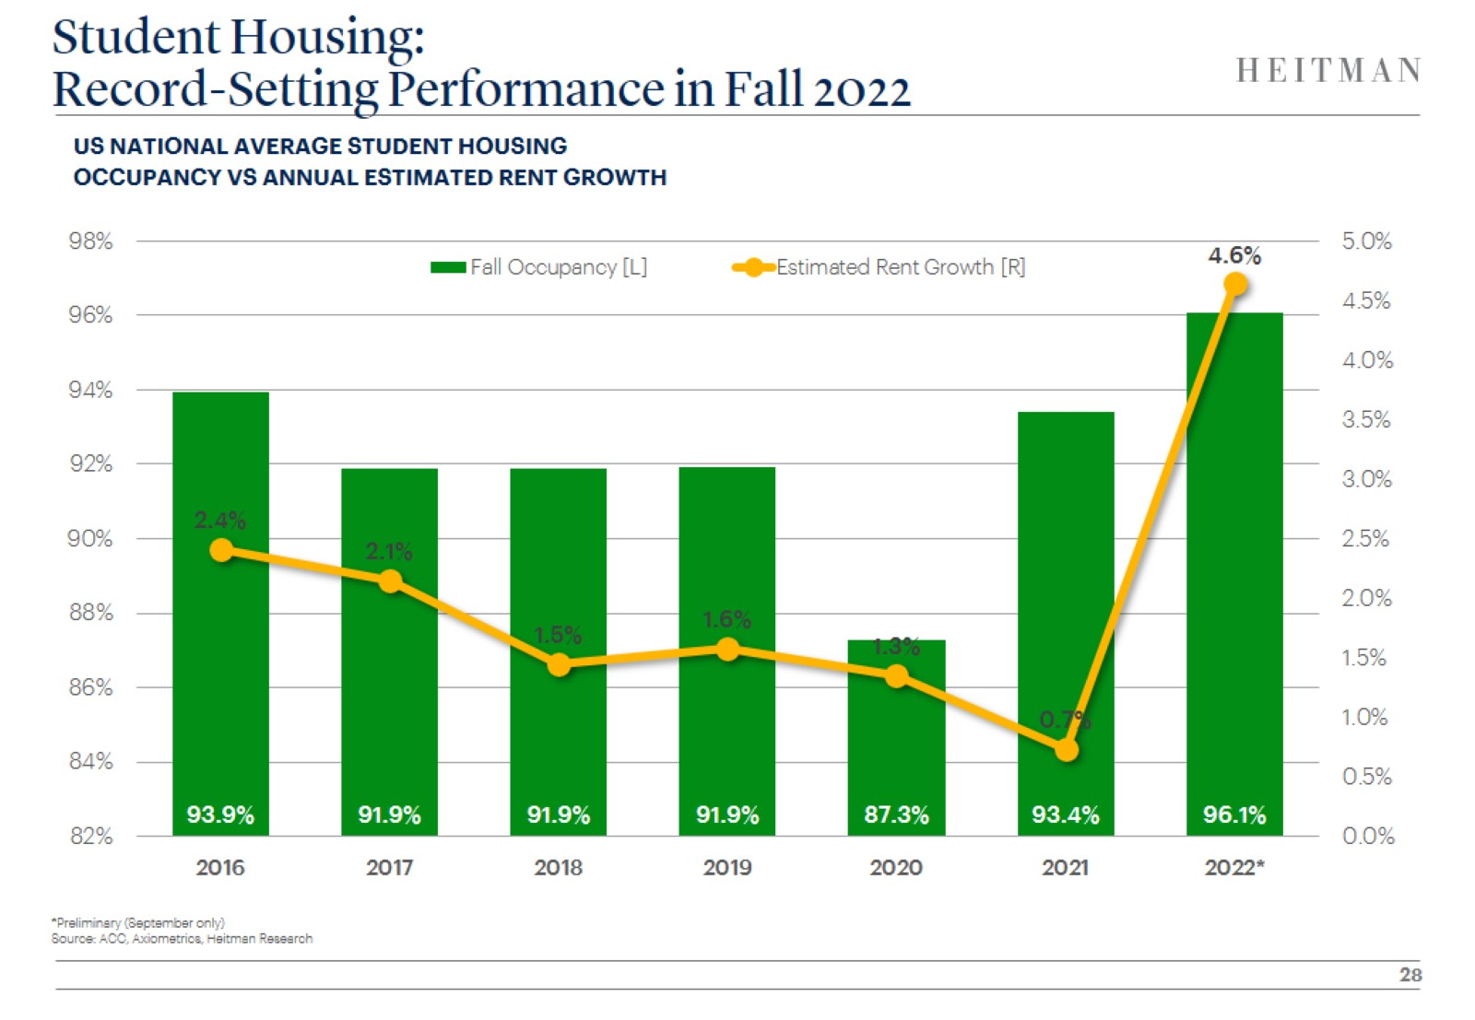
Student Housing:
Record-Setting Performance in Fall 2022

Slide 29
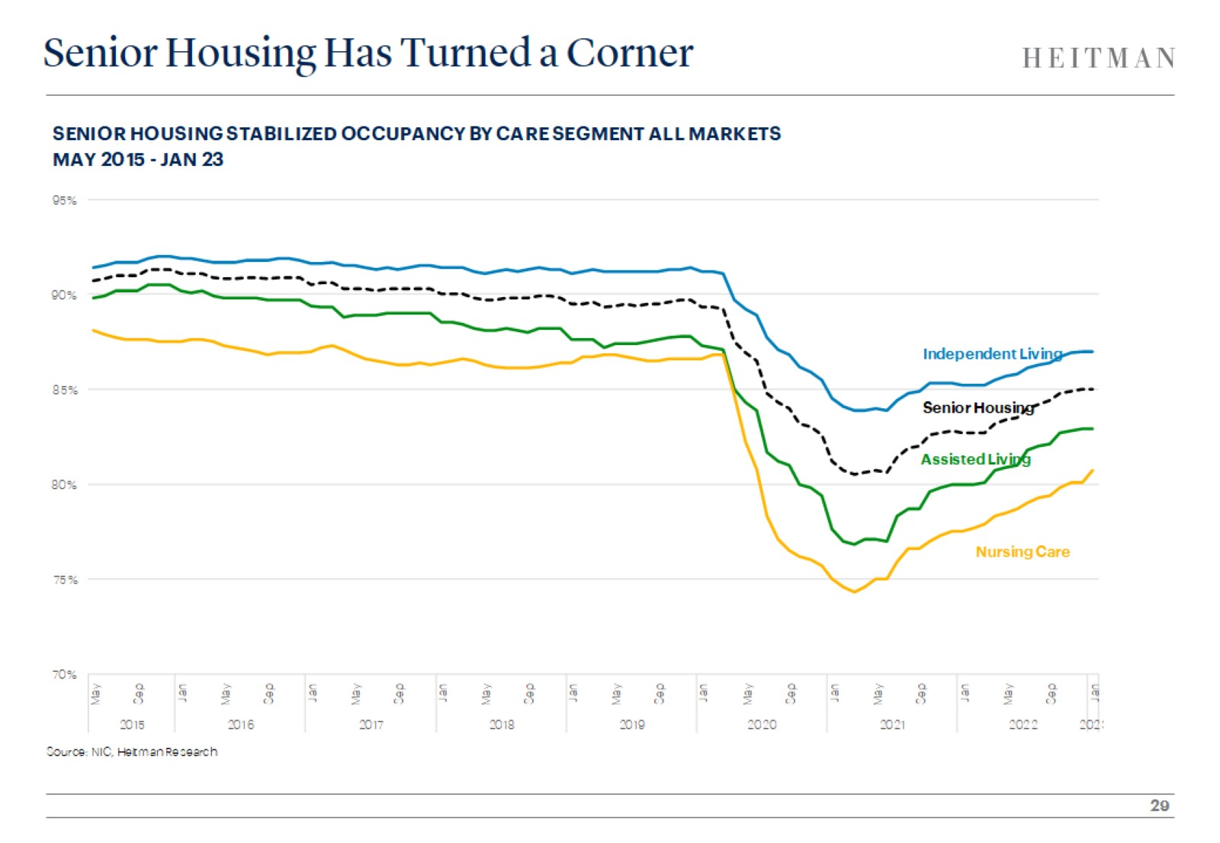
Senior Housing Has Turned a Corner

Slide 30
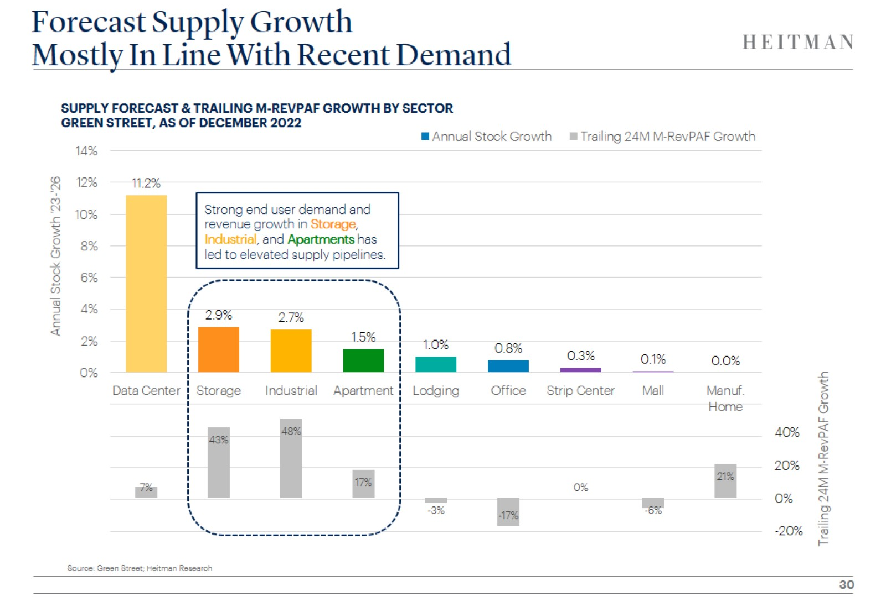
Forecast Supply Growth
Mostly In Line With Recent Demand

Slide 31
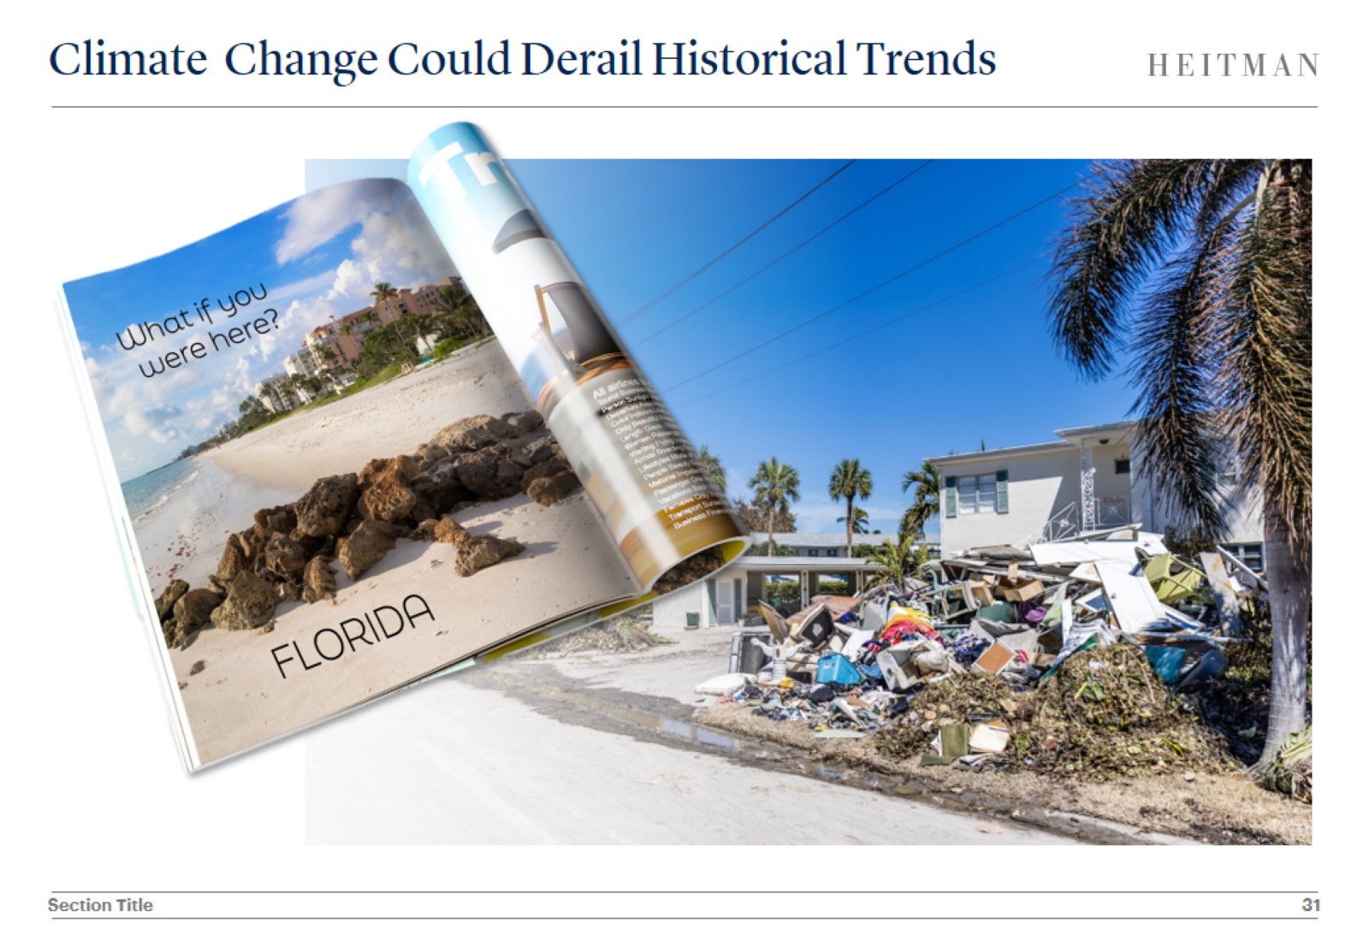
Climate Change Could Derail Historical Trends

Slide 32
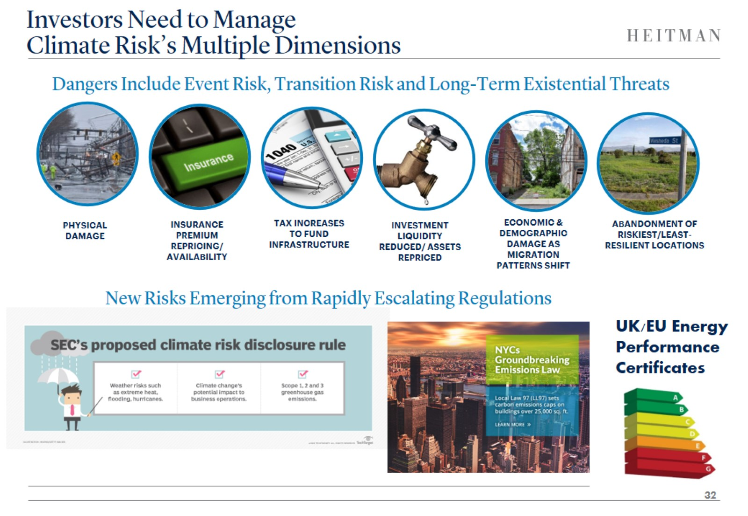
Investors Need to Manage
Climate Risk’s Multiple Dimensions

Slide 33
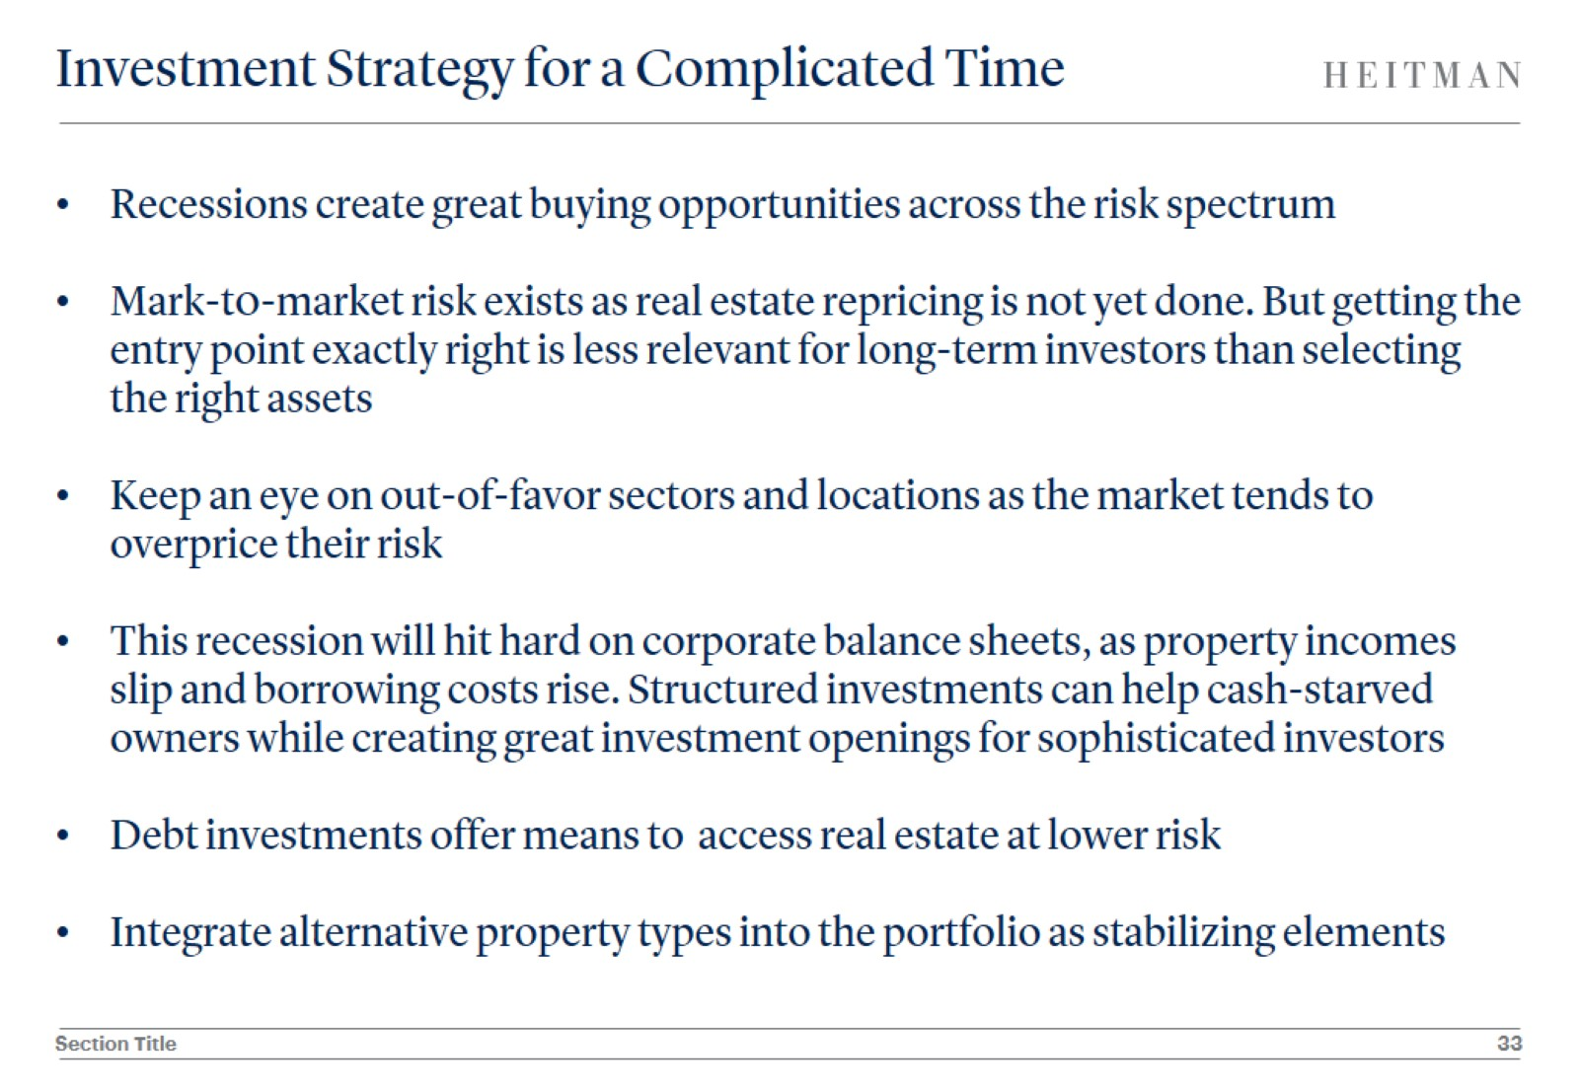
Investment Strategy for a Complicated Time

