Slide 1
State of the Chicago Residential Markets
May 2021
Integra Realty Resources (IRR) – Chicago
Ron DeVries, MAI
1 N Franklin, Suite 3010
Chicago, IL 60606

Slide 2
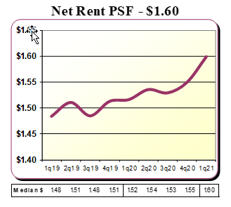
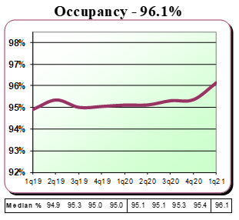
The Suburban Dataset – 1Q21
The gift that keeps on giving…

Slide 3
Class A & B Rent Trends Downtown – 1Q21
Rents within roughly 10% of pre-pandemic levels

Slide 4
Class A & B Concessions Downtown – 1Q21
The fire sale is coming to an end

Slide 5
DT Occupancy Trends – 1Q21
Low pricing and return to work expectations are driving demand

Slide 6
Absorption Record
Just under 2,700 units absorbed in 1Q21 – projecting over 5,000 units for the year
Projected deliveries will be down sharply

