Slide 1
About Us
AW Properties Global, in conjunction with AuctionWorks, offers best in class real estate consulting, brokerage and auction services. We specialize in handling complex real estate transactions and delivering rapid results.
We are your special situation broker—we handle dispositions, acquisitions, receiverships, lease restructuring, and portfolio analysis & restructuring.
Today I will focus on dispositions—whether a premier or distressed property, or real estate being sold with an operating business, our team is poised to help sell and optimize the value of the asset(s).
Our team specializes in valuing and selling real estate and real estate with a business, including all asset classes of commercial and residential real estate. Optimizing value for our client is always our number one goal. For all of our sales, we aggressively promote our listings to our substantial proprietary database of brokers and investors nationwide.
Our real estate sales have included all asset classes:
  Industrial
  Retail
  Multi-Family
  Office
  Mixed Use
  Land
  Specialty Use ( e.g. golf courses, senior housing, car washes, asphalt plants, medical/healthcare centers, gas stations etc.)
  Residential

Slide 2

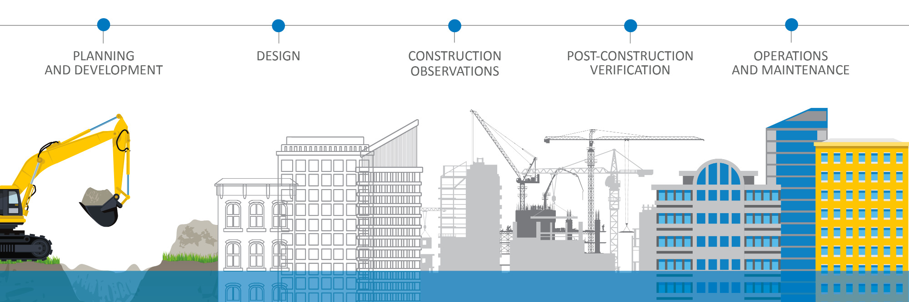
GEOTECHNICAL
CONSTRUCTION MATERIALS
FACILITIES
ENVIRONMENTAL
CONTACT INFO

Slide 3

SERVICE LINES
ENVIRONMENTAL
Phase I and II Environmental Site Assessments
HUD/IHDA/LIHTC Phase I ESA’s
Transaction Screen Process (TSP)
Previous Report/Document Review
Environmental Database Review (i.e., desktop review)
RSRAs
Limited Phase I ESA’s
Phase III Feasibility Study and Remedial Design
Property Condition Assessments (PCA’s)
Wetland Delineation and Permitting
Asbestos and Lead-Based Paint Services
Indoor Air Quality Assessment (IAQ)
Hydrogeologic and Ground Resources Services
Mold Assessment, Inspection and Evaluation
Stormwater Services
SERVICES INCLUDE
Determine potential environmental impacts associated with your project
Notes:
Today I am going to talk about,
the overall structure
our service
supporting your offices
and our strategy moving forward

Slide 4
Disposition Services
The disposition method we may recommend will vary based on the type, location and condition of the asset as well as the client’s specific needs and timing. Below are the types of sale methods we regularly employ:
Accelerated Sales
Auction Sales
Sealed Bid Sales
Call For Offers
Confidential Off Market Sales
Bulk/Portfolio Sales
Sale/Leasebacks
363 Sales
The AW team powerfully combines its local market expertise with a proprietary eblast marketing database and social media marketing database that includes over 15,000 local brokers, investors, and real estate professionals, over 13,000 social media contacts, and over 100,000 national and international contacts.

Slide 5
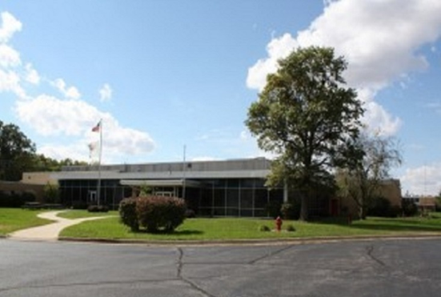
Case Study
Former Bosch Manufacturing Facility — Watseka, IL
Client — Bank
Challenge — This vacant, approximately 177,000 sf industrial building set on 55 acres presented multiple disposition challenges. It was located in a remote location in central Illinois. It had significant roof repair/replacement requirements (est. $1MM+).
The facility had failed/incomplete Phase 1-2 environmental reports. There were 30 excess acres located in a flood plain and it was situated near an area that recently experienced 100 year high flood levels.
Solution

Slide 6
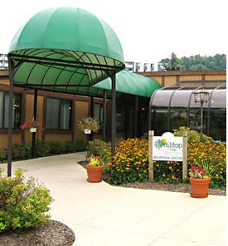
Case Study
Hilltop Village Independent Senior Housing — Euclid, Ohio
Client — Chief Restructuring Officer
Challenge — When the owner of this independent living community passed away, his estate hired a chief restructuring officer (CRO) to assist it in managing a pre-bankruptcy situation. The CRO in turn hired the AW team to accelerate the sale of this asset. Specifically, the AW team was charged with selling the operating 196 unit senior housing business as well as the real estate (an approximately 178,000 sf building set on 19.39 acres). The goal was for the estate to be able to use the proceeds from the sale to satisfy creditors and thereby avoid filing for bankruptcy. If the AW team could sell the operating business plus the real estate for a sufficient dollar amount by a date certain, the estate could satisfy the creditors. If not, the AW team would be tasked with conducting a 363 sale/bankruptcy auction of this asset and it would likely sell for a much lower price.
The sale of this property was particularly challenging due to its location in an economically challenged area just outside of downtown Cleveland. Specifically, the primary market area was lower income and could not support the higher rents that could be achieved in other suburbs of Cleveland. Additionally, some anticipated regulatory changes relating to fire suppression requirements threatened to add substantial cost for any new owner.
Solution
.

Slide 7
Case Study
Industrial/Office/Flex – Elgin, IL
Client — Private Investor
Challenge — The owner of this vacant, approximately 95,512 sf former medical building set on 10.04 acres originally had purchased it with the intent of converting it into a trampoline park. The building was part of a portfolio of commercial real estate the owner recently had purchased nationwide. When the owner decided against converting the building, he listed it for sale with a very large, nationally known commercial real estate brokerage firm. Initially the asking price was $4,000,000. Over time, the brokers substantially lowered the asking price, but still the property did not sell. At the time the seller engaged the AW team to auction the property, the most recent asking price with the prior listing brokers had been $2,900,000.
The sale of this property was particularly challenging due to its large size, its 100% vacancy and its location on the border of two counties that had very disproportionate real estate property taxes (the property was in the county that has a much higher property tax level than the literally yards away, adjacent county).
Solution

Slide 8
Let’s Connect!
  Emily S. Gottlieb, Esq.
  Senior Vice President, Bankruptcy & Restructuring and Managing Director of Business Development
  Email: emilyg@awproperties.com
  Cell: 773-294-1155
  https://www.linkedin.com/in/emily-gottlieb-a523bb4/
  www.awproperties.com

Slide 9

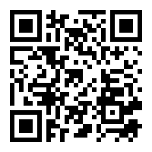
CONTACT INFO
LAUREN ZANGL
BUSINESS DEVELOPMENT MANAGER
LZANGL@ECSLIMITED.COM
224.688.9858
www.ecslimited.com

