Slide 1

REIA Hot Topic
THE STATE OF CHICAGO ZONING
May 6, 2021
This information does not, and is not intended to, constitute legal advice. All information, content and materials are for general informational purposes only. No reader should act, or refrain from acting, with respect to any particular legal matter on the basis of this information without first seeking legal advice from counsel in the relevant jurisdiction.

Slide 2
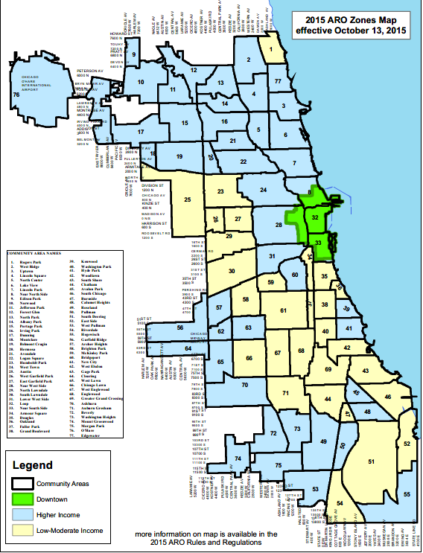
2021 Affordable Requirements Ordinance (ARO)
Prior to 2007 – No Mandatory Affordable Housing Requirement
  FAR Bonus program provided mechanism for developers to provide (or fund) affordable housing in return for more floor area
2007 ARO – Established Mandatory Requirements
  10% / 20%
  Allowed for a total buy-out @ $100,000 per unit
2015 ARO
  Increased fee in lieu (with annual escalation)
  Total buy-out no longer possible
  Pilot Programs increased (2017)

Slide 3
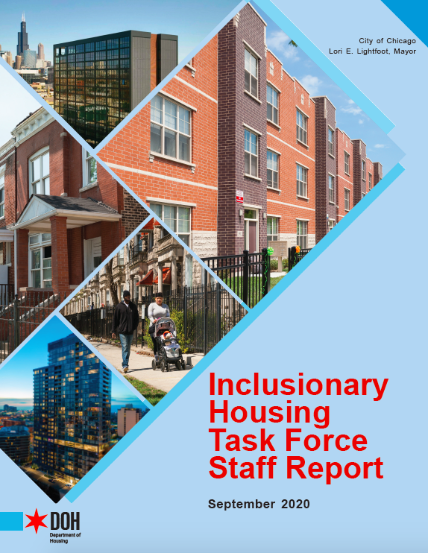
2021 Affordable Requirements Ordinance (ARO)
Timeline:
Fall 2019 - Mayor Lightfoot convenes Inclusionary Housing Task Force
Fall 2020 – Task Force Issues Staff Report
March 2021 – 2021 ARO Introduced to City Council
April 15 and 20, 2021 – Housing Committee Hearing
April 2021 – City Council Approval

Slide 4
2021 Affordable Requirements Ordinance (ARO)
Effective date and “grandfather” provisions:
Key Dates: October 1, 2021 and October 1, 2025
2015 ARO “safe harbor”:
Rezoning/PD ordinance approved by October 1, 2021
  –AND-
Building permit application submitted by October 1, 2025 (or within the applicable PD sunset period)
No 2007 ARO “safe harbor”

Slide 5

2021 Affordable Requirements Ordinance (ARO)
Expanded Trigger – from “Rezoning” to “Entitlement”
  New in 2021:
    New PDs in any zoning district to a PD (not just Downtown)
    Residential (R) district floor area premiums
    Administrative adjustments and variations that allow for development of non-conforming lots or existing developments
    TSL floor area premiums and MLA reductions
    Zoning change from a zoning district that only allows ground floor residential as a special use to one that allows ground-floor residential as a permitted use.
    Minor changes to PDs that permit a higher floor area ratio or increase the number of dwelling units
Notes:
“Project” is still 10 or more dwelling units
Land Sale and TIF are still triggers

Slide 6
2021 Affordable Requirements Ordinance (ARO)
New Framework - Four “Areas”:
Low-Moderate Income Area
Inclusionary Area
Community Preservation Area
Downtown Districts

Slide 7
2021 Affordable Requirements Ordinance (ARO)
Overall Requirements – Low-Moderate Income Areas
  Rental:
    10% requirement at weighted average of 60% AMI
    80% AMI max
  Owner-Occupied:
    8 or 10% requirement, depending on weighted AMI
    120% AMI max

Slide 8
2021 Affordable Requirements Ordinance (ARO)
Overall Requirements – Everywhere Else
  Rental:
    Up to 20% requirement at weighted average of 60%
    80% AMI max
    Options to provide less than 20% at lower AMI levels
  Owner-Occupied:
    16 or 20%, depending on weighted AMI
    120% AMI max
    Option to provide less than 20% at lower AMI levels
Notes:
As low as 10% at weighted average of 30% AMI (rental) / 16% at weighted average of 80% AMI (owner-occupied)

Slide 9
2021 Affordable Requirements Ordinance (ARO)
Changes to Location Requirements and Fees in Lieu
  Rental:
    25% required on-site (used to allow off-site within 2 miles)
    25% either on-site or off-site
    Remaining 50% on- or off-site, or fee in lieu
  Owner-Occupied:
    50% on- or off-site
    50% on- or off-site, or fee in lieu
    Note: No longer a full buy-out option in Downtown Districts
Notes:
Off-site units must be located in a downtown district, inclusionary area or community preservation area (i.e., cannot be in low-moderate income area)
If triggering project in community preservation area, off-site units must be located within 1 mile
If triggering project is in a TSL, must also be in “substantially comparable” TSL
Minimum 2 bedrooms
New ordinance allows developers to “bridge” timing issue – by placing funds in escrow, thereby waiving requirement that certificate of occupancy be issued for affordable units at the same time as the market rate units

Slide 10
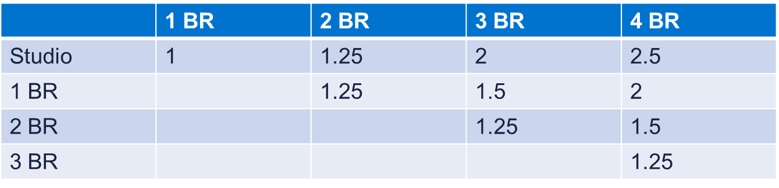
2021 Affordable Requirements Ordinance (ARO)
Incentive for Family-Sized Units
Notes:
Miscellaneous changes – DOH is authorized to enter into service agreements to help with marketing, income qualification, etc.

Slide 11
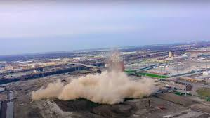
Air Quality Ordinance
Approved March 2021
New special use / PD approval requirement
  Residential/public uses in R and B/C districts that are within 660’ of certain industrial uses (including warehouse/distribution)
  Warehousing, Wholesaling, and Freight Movement on C and PMD-zoned property ≥ 10 acres
  Industrial Uses on M-zoned land ≥ 10 acres
  Certain industrial uses on C-zoned and PMD-zoned land ≥ 10 acres or located within 660’ of R, B, C or POS district
Limits retail and daycare uses
Eliminates some industrial uses (Mining/Excavation, Incinerators)

Slide 12
Air Quality Ordinance
Site Plan Review Criteria
Waste-related uses; recycling facilities; intensive manufacturing production and industrial service uses; warehousing, wholesaling, and freight movement; container storage; freight terminal; outdoor storage of raw material as a principal use; coke & coal bulk material uses; window composting and manganese-bearing material operation use
Required Impact Studies
  Traffic Study – CDOT must review
  Air Quality Impact Evaluation – CDPH must review
  Both subject to public comment
  Joint written recommendation to Zoning Administrator
Community Meeting
  Must occur at least two weeks prior to filing request for site plan review
  Coordination with DPD – “to promote public access”
  Published and mailed notice
Notes:
Sequencing

Slide 13
Air Quality Ordinance
One more thing…
Written notice of all special use, map amendment, and PD applications must be provided to the Alderman
Notes:
Sequencing

Slide 14
Master Plan / Master PD Review
What is a “Master PD”?
1. PD with privately-owned land (except waterfront sites and industrial uses)
Site Area ≥ 20 acres (gross) or 15 acres (net)
Floor Area ≥ 4 million sf (total) or 3 million sf increase
Combined D.U., hotel keys, Group Living Units ≥ 4,000 (total) or 3,000 incremental increase
City-owned land / City as co-applicant / Waterfront / Industrial
Site Area ≥ 15 acres (gross) or 10 acres (net)
Floor Area ≥ 3 million sf (total) or 2.5 million sf increase
Combined D.U., hotel keys, Group Living Units ≥ 3,000 (total) or 2,500 incremental increase
Notes:
Approved April 2021

Slide 15
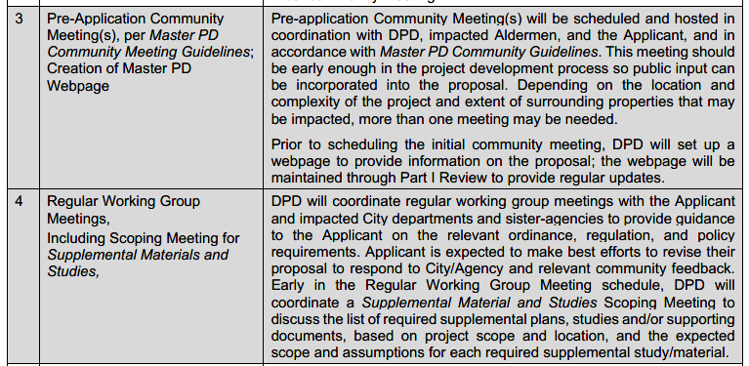
Master Plan / Master PD Review
New Steps:
Community Engagement
Community Meetings – Pre- and post-filing
Convene a Working Group
Post-Approval Site Plan Review – including community engagement and working group meetings
Notes:
Approved April 2021

Slide 16
Master Plan / Master PD Review
New Procedural Requirements
Community Meetings – Pre- and post filing; post-approval site plan review
Community Impact Assessment
Traffic Study
Economic Impact Statement
Conformance to City Policies and Initiatives
Supplemental Materials and Studies
  Parking demand and impact
  Environmental Assessment
  Community Facilities, Infrastructure & Housing
  Sunlight / Shadow Study
  Wind Impact
Notes:
Approved April 2021

Slide 17
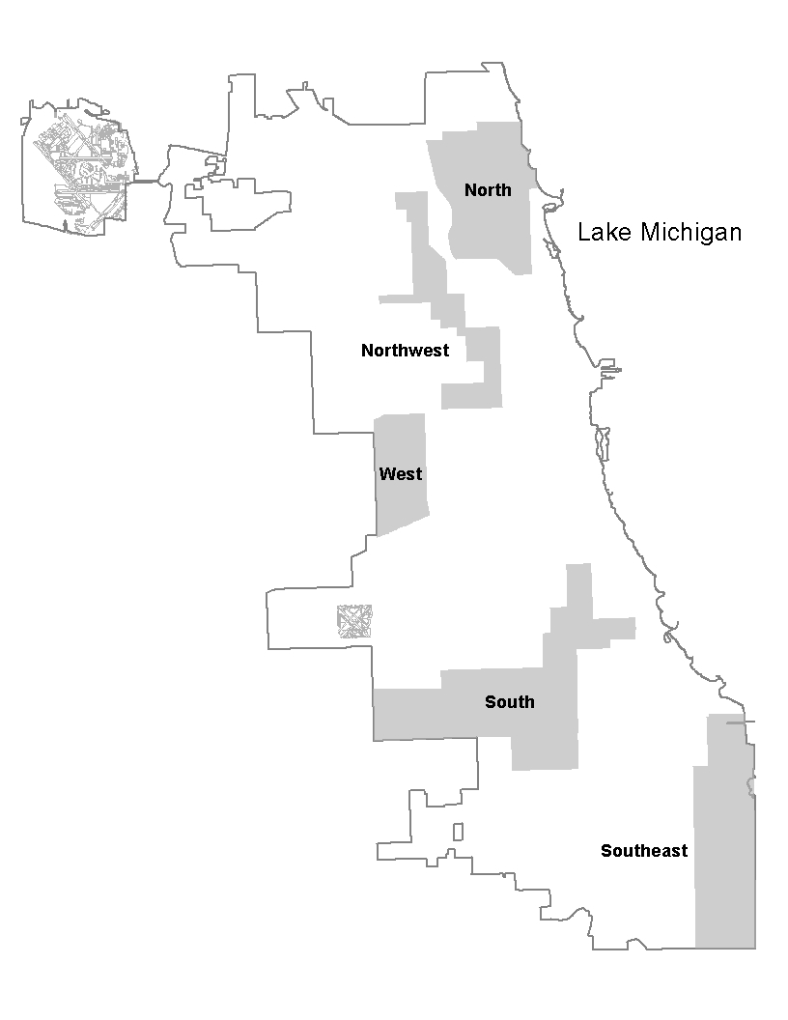
ADU Ordinance
Coach Houses and Conversion Units
Coach Houses are accessory buildings - new or existing
Conversion Units are – located within a principal residential building that has been in lawful existence for 20 years or more
Conversion Units – 50% affordability requirement
50% of conversion units must be maintained as affordable (60% AMI) for 30 years

Slide 18
ADU Ordinance – Coach Houses
Approved December 2020
BUT – “Kick-off” date of May 1, 2021
  Modest Solution
  Allowed in five designated Additional Dwelling Unit-Allowed Areas
  Limited to properties with 4 or fewer established dwelling units
    In the West, South, and Southeast Zones – properties with 3 or fewer established dwelling units must be owner-occupied
  Free from underlying FAR, MLA, parking, rear setback, and on-site open space requirements
  Tight restrictions around building siting and bulk – minimum building separation; 700 sf floor area maximum; lot coverage limits
  Note: Ineligible for AirBNB and VRBO platforms

Slide 19
EV Readiness
Approved April 2020
Permit applications for new construction submitted after October 31, 2020
  Residential Buildings - 5 or more dwelling units
  Nonresidential Buildings – 30 or more parking spaces are provided
  20% of the parking spaces must be EVSE-Ready or EVSE-Installed
  17-17-0251.5-C Electric Vehicle Supply Equipment Infrastructure. The electrical infrastructure necessary to support future installation of electric vehicle supply equipment, including, but not be limited to, the design load placed on electrical panels and service equipment to support the additional electrical demand, the panel capacity to support additional feeder/branch circuits, raceways, and wiring.
17-17-0251.5-D EVSE-Ready. Having electric vehicle supply infrastructure installed so as to provide conduit and wiring for a 40-ampere, 208- or 240-volt dedicated branch circuit terminating at a receptacle, junction box, or electric vehicle supply equipment adjacent to the parking space.
17-17-0251.5-E EVSE-Installed. Having such electric vehicle supply equipment and electric vehicle supply infrastructure installed so as to be EVSE-Ready, including an installed electric vehicle charging station.

Slide 20
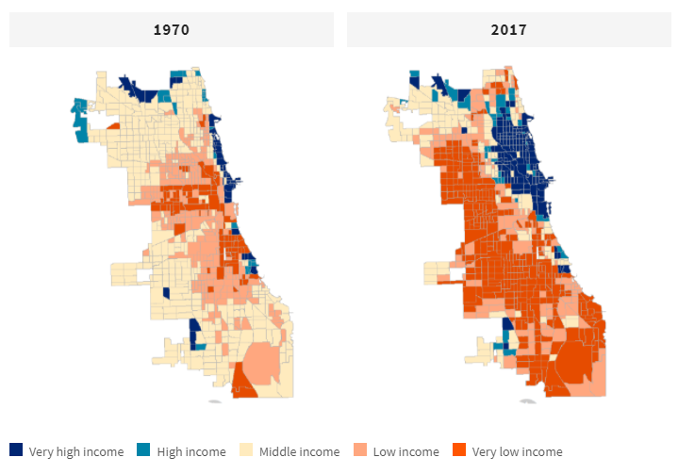
We Will Chicago
Notes:
Cmr. Cox cited this map to assert that there has been a 50-year “redistribution of wealth”. Cmr. Cox argued that the absence of a city-wide comprehensive plan is one of the reasons for Chicago’s population decline.
Three-year process
First stage, past 6 months – talking with residents and stakeholders

Slide 21
We Will Chicago – 2021 (Year 2)
Two Principles: Equity and Resiliency
Five Themes: A roadmap for the process
Seven Pillars: Qualify of Life Drivers to be Addressed
DPD is currently formulating the outreach and engagement plan for this stage
Community partners for each pillar have been enlisted
Year 1 – 2020
Mobilization & Pre-planning
Stakeholder interviews
Year 2 – 2021
Research
Policy Action Plans
Advisory Council and Research Teams
Online Input
Year 3 – 2022
Present Comprehensive Plan to Chicago Plan Commission and City Council for review/approval
Notes:
5 Themes:
Historical Reckoning & Trust Building
Evaluation of Equity Impacts
Community Engagement
Accountability
Interagency & Cross Collaboration
7 Pillars:
Arts & Culture
Economic Development
Environment, Climate & Energy
Housing & Neighborhoods
Lifelong Education
Public Health & Safety
Transportation & Infrastructure

Slide 22
Questions?
Mariah DiGrino
DLA Piper LLP (US)
mariah.digrino@us.dlapiper.com

Slide 23
Thank you

