Slide 1
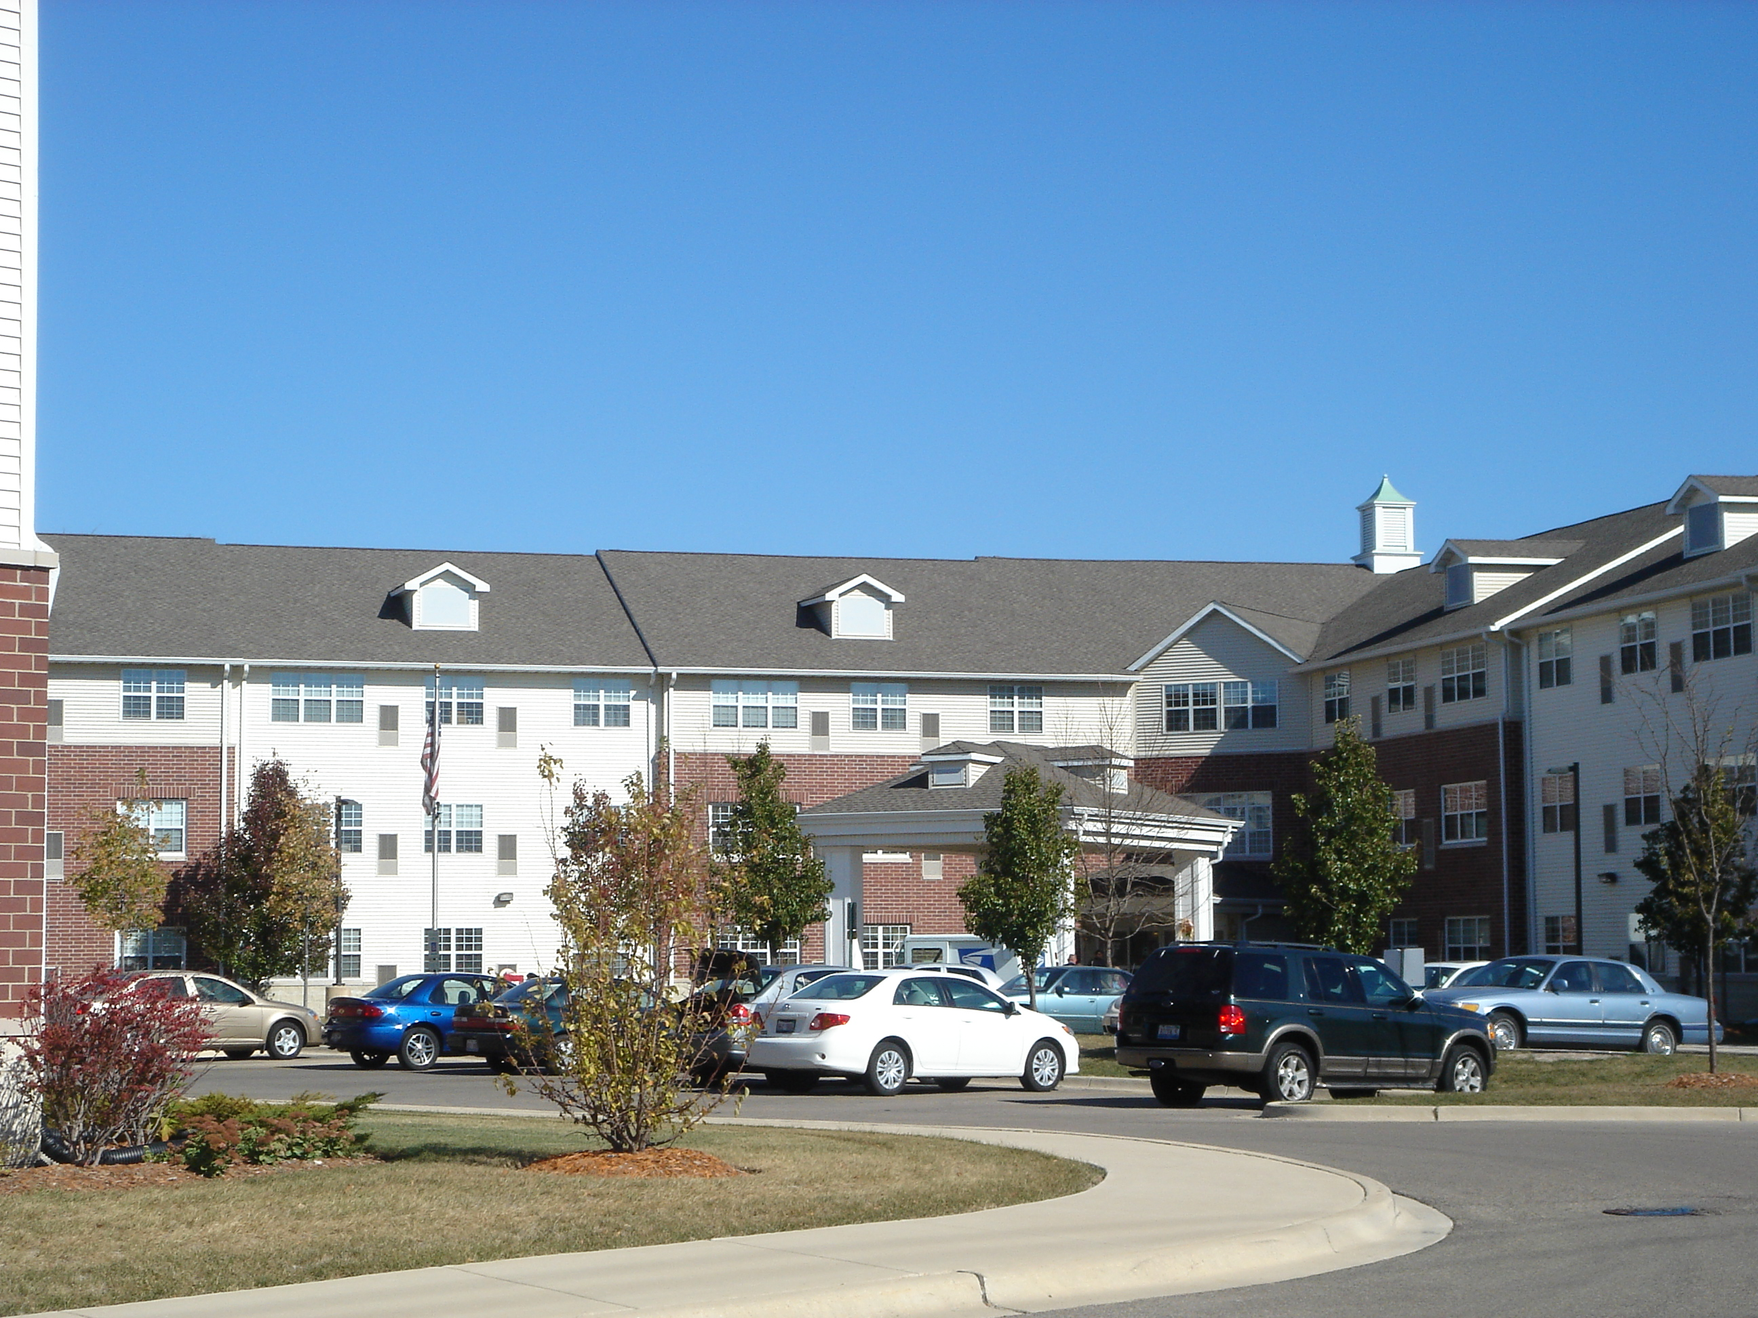
National Equity Fund Highlights
Established in 1986
Syndicator of the LIHTC and HTC
Affiliate of LISC, a national nonprofit intermediary
$14.4 Billion Invested*
  $1.4 Billion Disposed (Funds)*
$12.9 Billion Under Management*
  $12.3 Billion NEF Originated*
  $0.59 Billion Third Party*
Over 2,492 Projects Closed
  e1,434 Under Managment
  1,058 Disposed
188 Funds Under Management*
$157 Million to LISC*
*As of YE 2017 (all other data as of YE 2016)
Heritage Woods of Batavia II| Batavia, IL
National Equity Fund 2007

Slide 2

Low Income Housing Tax Credit
  Created in 1986 as part of the Tax Reform Act to encourage private investment in affordable housing
  Competitive Process. Credits allocated thru the State Housing Finance Agencies (IHDA ) per a QAP
  Long term restricted rent restrictions (60% AMI or less)
  Currently a $7 billion market.
  Majority of purchasers of the LIHTC are banks (due to CRA obligations) and insurance companies.
  $1 for $1 reduction in federal income tax.
  Capital Stack: LIHTC equity generally 30 – 50% of TDC

Slide 3
Summary: How Tax Credits Flow
Federal Government
Allocates Low-Income Housing Tax Credits to States
TAX CREDITS
THE LOW-INCOME HOUSING
TAX CREDIT INVESTMENT
PROCESS
State Housing Agencies
Allocate Credits to Properties
TAX CREDITS
LIMITED PARTNERSHIP
-
PROPERTY OWNER
CORPORATE INVESTOR
TAX CREDITS & LOSSES
TAX CREDITS & LOSSES
Residential Rental Properties
for qualified residents with incomes not exceeding 50% to 60% of area median income
$
$
Source: Reznick

Slide 4
Federal Historic Tax Credits
  For properties that are on the National Register of Historic Buildings.
  Historic Credit equal to 20% of the eligible historic basis
  5 year recapture period
  Used for commercia or residential. Can be paired with the LIHTC or NMTC
  Investors generally banks or insurance companies

Slide 5

What are Opportunity Zones?
The Opportunity Zone tax incentive was established by Congress in the 2017 Tax Cuts and Jobs Act as an innovative approach to spur long-term private investment in low-income urban and rural communities. This new initiative is based on the bipartisan Investing in Opportunities Act, championed in large part by senators Tim Scott (R) and Cory Booker (D).
U. S. investors currently hold $2.3 trillion in unrealized capital gains, representing a significant untapped resource for economic development
Washington Square Park
Cincinnati, OH
Notes:
KAREN
Start with a short overview of NEF/LISC interest/activities in Opportunity Zones.

Slide 6
What are Opportunity Zones?
Opportunity Zone: A low-income census tract (LIC), as determined within New Markets Tax Credits legislation, is designated as an Opportunity Zone (OZ) by the governor of the of the state or territory in which it is located. Designations will stay in place for 10 years. 8,762 were designated for this program.
  Up to 5% of census tracts contiguous to LICs
  may be designated as OZs, if the median family income of the census tract does not exceed 125% of the median family income of the LIC to which the tract is contiguous.
  States or territories in which there are fewer than 100 LICs may designate up to 25 LICs as OZs.
Up to 25% of LICs
in a U.S. state or territory may be designated as OZs.
Notes:
KAREN

Slide 7
Definitions
Opportunity Fund: An investment vehicle organized as a corporation or partnership for the purpose of investing in Opportunity Zone property.
Opportunity Funds will be self-certified per IRS guidelines. They must be organized for the purpose of investing in Opportunity Zones
Opportunity Funds are required to invest 90% or more of their capital as EQUITY in Opportunity Zone property
Investors receive a return on their investment through a seven-year stream of tax credits (totaling 39%).
Opportunity Zone property includes stock, partnership interest, or business property in an Opportunity Zone

Slide 8
OPPORTUNITY ZONES
Investor Incentives
Review -
Deferral of taxes paid on capital gains when invested in Qualified Opportunity Zone Fund within 180 days of gain being realized.
10% Reduction of taxes paid on capital gains for investments held over 5 years and additional 5% if investment held 7 years. BUT capital gains tax must be paid 2026.
No Capital Gains tax on New investment if investments held 10+ years.

Slide 9
Timeline for Opportunity Zone Investments
Investment Year
2018
Year 5
2023
Year 7
2025
Year 8
2026
Year 10
2028
Gain realized and invested in Opportunity Fund within 180 days*
10% reduction of capital gains tax
15% reduction of capital gains tax
All taxes due on 12/31/26. Investor pays tax on 85% of original gain
Tax on Capital
Gain Invested
* Tax is deferred until the earlier of investment liquidation (return of capital) or 12/31/26
Any gain realized on Opportunity Fund investment is fully taxable if liquidated
Any gain realized on Opportunity Fund investment is fully taxable if liquidated
Any gain realized on Opportunity Fund investment is fully taxable if liquidated
Any gain realized on Opportunity Fund investment is tax free**
Tax on Opportunity Fund Investment
** Any appreciation on Opportunity Fund investment is tax free if held > 10 years

Slide 10
Key Points
Funds
Eligible Investments
Tax incentive is most valuable for 10 year investments in appreciating assets
Six months to invest after realizing a capital gain
Another six months to deploy 90% of capital in Zones
Capital is required to be an equity investment – loans from investors are not eligible for the tax incentive
  Must be equity investments
  Real estate investments must include substantial rehabilitation – doubling basis within 30 months
  “Sin businesses” are not eligible
  Other requirements include property use in “active conduct of business” and limits on assets held in cash
Investors
  All capital must flow through an Opportunity Fund to be eligible for the tax incentive
  Funds are self-certified via an IRS tax form
  Fund must be established for the purpose of investing in Opportunity Zones
  90% of fund assets must be invested in Zones to maximize the tax incentive

Slide 11

Taxpayer
A taxpayer has 180 days to invest unrealized capital gains into a QOZ Fund, and the fund has up to 180 days to invest 90% of those gains in QOZ Business Property.
QOZ Fund
QOZ Stock
(QOZ Business)
QOZ Partnership (QOZ Business)
QOZ Business Property
QOZ Business Property
QOZ Business Property

Slide 12
Economic Development Examples
1
Business infrastructure real estate funds:
Industrial
Retail
Mixed use
TOD
2
Venture capital funds:
Seed stage investments
Series A investments
3
Operating business private equity:
Equity recapitalizations
Growth capital investments
4
Enhancement for other federal tax credit transactions:
NMTCs
Historic Tax Credits
Notes:
KAREN

Slide 13
Affordable Housing Examples
1
Pairing with LIHTC or the HTC
Effective for providing housing for families at or under 60% AMI
Issues: Many traditional LIHTC investors do not have capital gains or they have minimal capital gains. Will they invest those into LIHTC deals in Ozones?
Timing of capital contributions will be different than in traditional LIHTC deals
2
Focus on Workforce Housing
Providing Housing for families at
80 – 120% AMI
Anticipate a 10 year investment
No ongoing compliance regulations unless required through local funding or zoning
Ability to attract High Net Worth Individuals or Corporations as investors

Slide 14
Workforce Housing Deal in Redmond, Oregon
New Construction of 116 units for families with rents at 90-110% AMI
Proven project in market (prior phases in non-Ozone locations)
Expect this to be Single Asset Opportunity Fund with High Net Individuals as investors
Capital Stack: Between 40 – 60% from ozone equity depending on return required by investor. Remainder of financing from non-recourse first mortgage.
Investors to get preferred annual cash payments
Exit scenario in year 10 - either sale or refinancing. Return of capital plus split of sales proceeds
Washington Square Park
Cincinnati, OH

Slide 15
INVESTORS
OPPORTUNITY FUNDS
Investors in Opportunity Zones
Because of the way the Opportunity Zones tool is structured,
there is a wide range of potential investors, including:
Banks and institutional investors that have previously invested in other tax credits
  Insurance companies
  High net worth individuals / Social Impact Investors
  Return parameters?

Slide 16
Opportunity Zones: What’s Next
Treasury expected to publish regulations and additional guidance by the end of September.
We expect to see a number of Opportunity Zone Funds with a variety of products by the end of the year.
What will be built? What is the social impact? There is much to be determined from a community development perspective.
Notes:
KAREN

Slide 17
Contact Information
Matt Josephs
Senior VP
LISC Policy
312-697-6131
mjosephs@lisc.org
lisc.org
Matt Josephs
Senior VP for Policy
LISC
202-739-9264
mjosephs@lisc.org
Kevin Boes
President/CEO
NMSC
312-697-6467
kboes@newmarkets.org
Beth Marcus
Senior VP
Resource Development
212-455-9398
bmarcus@lisc.org
lisc.org
Karen Przypyszny
Managing Director
Special Initiatives
NEF
312-697-6120
kprzypys@nefinc.org
nationalequityfund.org

